Slide 1


A Very Basic Introduction to Quantum Computing
CHPC SCC 2026 | Live Session | Demo

Slide 2

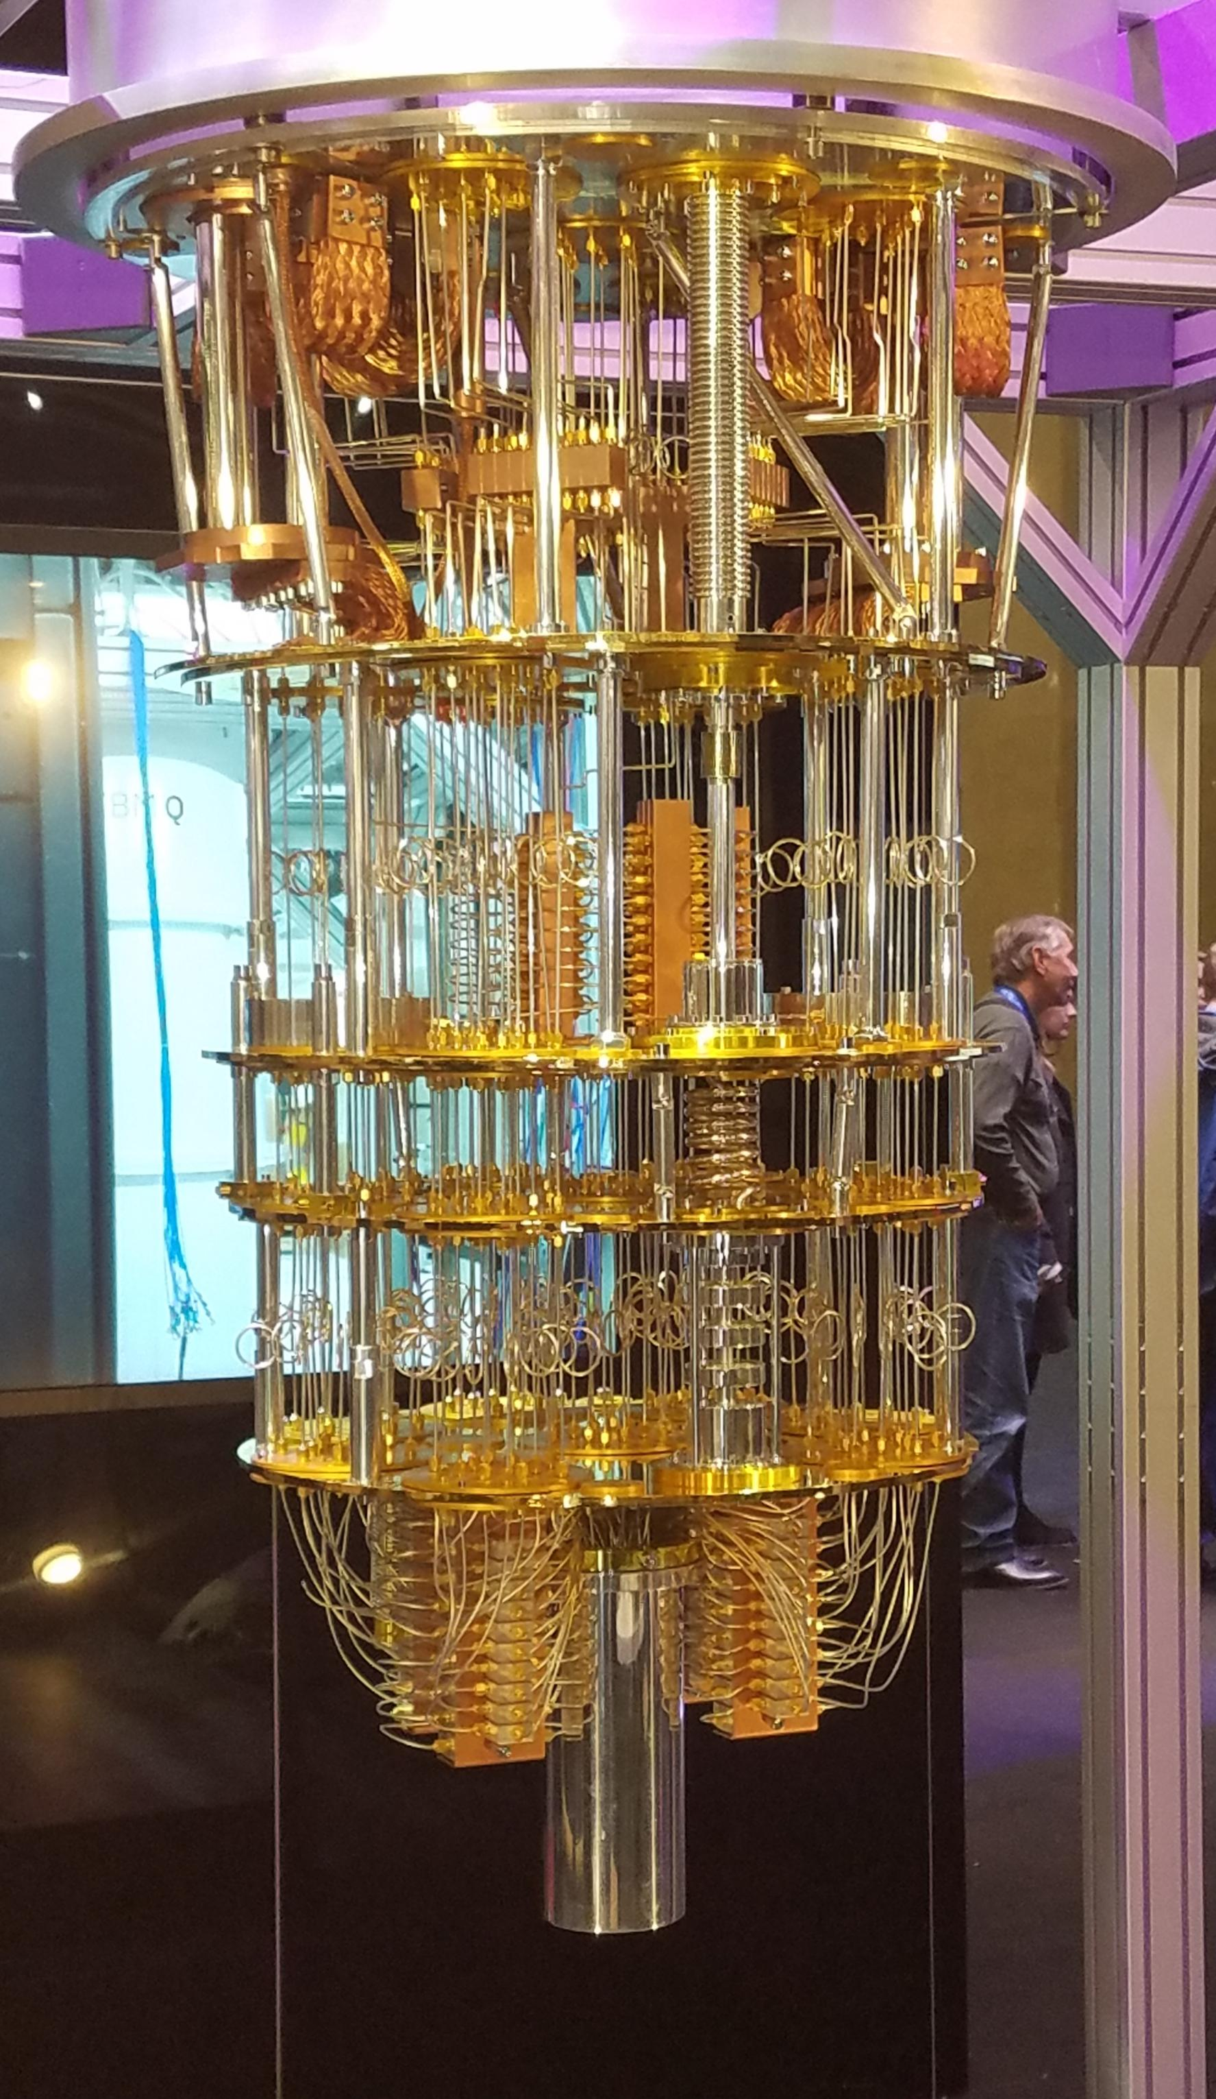
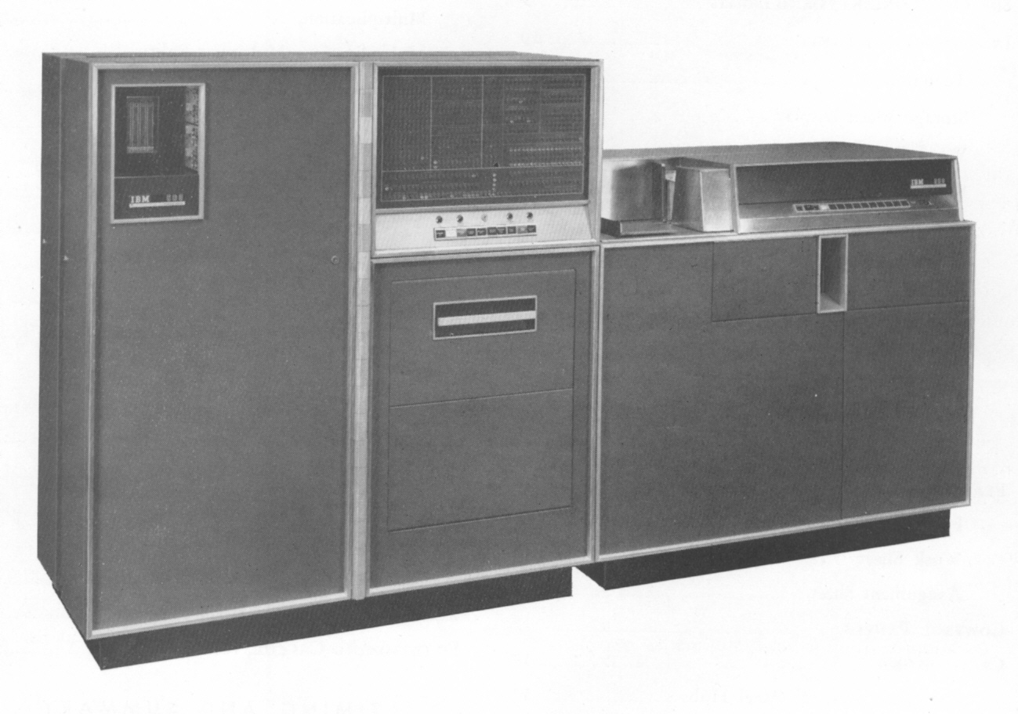


Evolution of Computing

Slide 3

Classical Bits versus Qubits
Classical Bit
Heads or Tails
Qubit
Superposition
Entanglement
Interference

Slide 4



Quantum Computing Use Cases

Slide 5
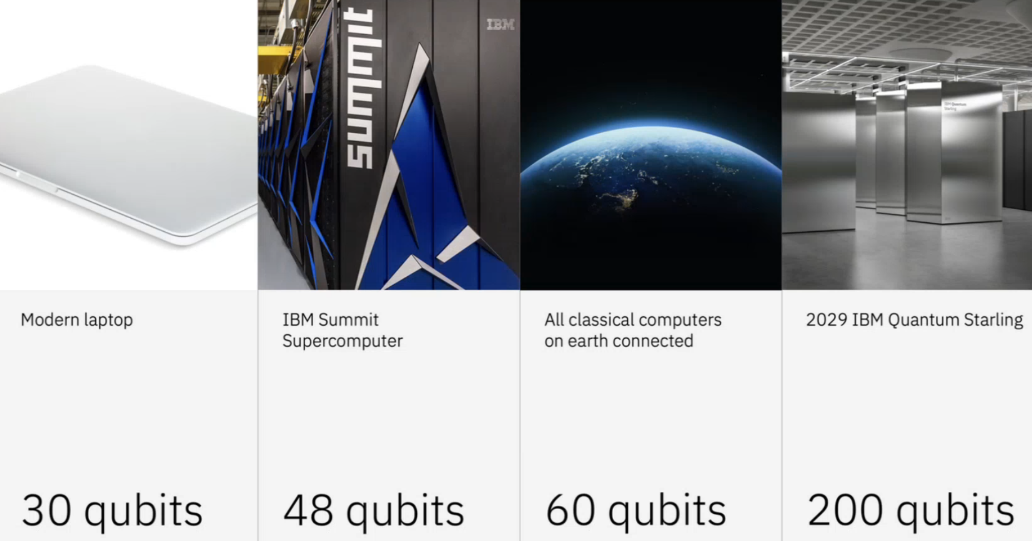
Quantum Computing Horizon

Slide 6
Demo: Overview

Slide 7
Demo: Overview
Install Python and Pip

Slide 8
Demo: Overview
Install Python and Pip
Configure Jupyterlab and Qiskit

Slide 9
Demo: Overview
Install Python and Pip
Configure Jupyterlab and Qiskit
Configure nftables and Security Groups

Slide 10
Demo: Overview
Install Python and Pip
Configure Jupyterlab and Qiskit
Configure nftables and Security Groups
Start Jupyterlab Server and Bind to Public IP

Slide 11
Demo: Overview
Install Python and Pip
Configure Jupyterlab and Qiskit
Configure nftables and Security Groups
Start Jupyterlab Server and Bind to Public IP
Work through “Basics” Notebook

Slide 12
Demo: Overview
Install Python and Pip
Configure Jupyterlab and Qiskit
Configure nftables and Security Groups
Start Jupyterlab Server and Bind to Public IP
Work through “Basics” Notebook
  Classical Bit

Slide 13
Demo: Overview
Install Python and Pip
Configure Jupyterlab and Qiskit
Configure nftables and Security Groups
Start Jupyterlab Server and Bind to Public IP
Work through “Basics” Notebook
  Classical Bit
  Single Qubit

Slide 14
Demo: Overview
Install Python and Pip
Configure Jupyterlab and Qiskit
Configure nftables and Security Groups
Start Jupyterlab Server and Bind to Public IP
Work through “Basics” Notebook
  Classical Bit
  Single Qubit
  Superposition

Slide 15
Demo: Overview
Install Python and Pip
Configure Jupyterlab and Qiskit
Configure nftables and Security Groups
Start Jupyterlab Server and Bind to Public IP
Work through “Basics” Notebook
  Classical Bit
  Single Qubit
  Superposition
  Measurement

Slide 16
Demo: Overview
Install Python and Pip
Configure Jupyterlab and Qiskit
Configure nftables and Security Groups
Start Jupyterlab Server and Bind to Public IP
Work through “Basics” Notebook
  Classical Bit
  Single Qubit
  Superposition
  Measurement
  Interference

Slide 17
Demo: Overview
Install Python and Pip
Configure Jupyterlab and Qiskit
Configure nftables and Security Groups
Start Jupyterlab Server and Bind to Public IP
Work through “Basics” Notebook
  Classical Bit
  Single Qubit
  Superposition
  Measurement
  Interference
  Entanglement

Slide 18
Demo: Overview
Install Python and Pip
Configure Jupyterlab and Qiskit
Configure nftables and Security Groups
Start Jupyterlab Server and Bind to Public IP
Work through “Basics” Notebook
  Classical Bit
  Single Qubit
  Superposition
  Measurement
  Interference
  Entanglement
  Coin Flips

Slide 19
Demo: Python Installation
On your [headnode]…

Slide 20
Demo: Python Installation
On your [headnode]…
Install Python and Python-Pip
  python -m venv <name>
  source <name>/bin/activate

Slide 21
Demo: Jupyterlab & Qiskit
In your [Python Virtual Environment]…

Slide 22
Demo: Jupyterlab & Qiskit
In your [Python Virtual Environment]…
Update Python Package Manager
  pip install --upgrade pip

Slide 23
Demo: Jupyterlab & Qiskit
In your [Python Virtual Environment]…
Update Python Package Manager
  pip install --upgrade pip
Install Qiskit
  pip install qiskit qiskit-aer ‘qiskit[visualization]’

Slide 24
Demo: Jupyterlab & Qiskit
In your [Python Virtual Environment]…
Update Python Package Manager
  pip install --upgrade pip
Install Qiskit
  pip install qiskit qiskit-aer ‘qiskit[visualization]’
Install Jupyterlab
  pip install jupyterlab matplotlib

Slide 25
Demo: Firewall and OpenStack
On your [headnode]…

Slide 26
Demo: Firewall and OpenStack
On your [headnode]…
Configure nftables and open TCP 8889

Slide 27
Demo: Firewall and OpenStack
On your [headnode]…
Configure nftables and open TCP 8889
On your [OpenStack workspace]

Slide 28
Demo: Firewall and OpenStack
On your [headnode]…
Configure nftables and open TCP 8889
On your [OpenStack workspace]
Configure the appropriate Security Groups

Slide 29
Demo: Launch Jupyter Server
On your [headnode]…

Slide 30
Demo: Launch Jupyter Server
On your [headnode]…
jupyter lab --ip 0.0.0.0 --port 8889 --no-browser

Slide 31
Demo: Launch Jupyter Server
On your [headnode]…
jupyter lab --ip 0.0.0.0 --port 8889 --no-browser
From your [web browser]

Slide 32
Demo: Launch Jupyter Server
On your [headnode]…
jupyter lab --ip 0.0.0.0 --port 8889 --no-browser
From your [web browser], navigate to
http://<PUBLIC IP>:8889/lab?token=<TOKEN>

Slide 33
Demo: Launch Jupyter Server
On your [headnode]…
jupyter lab --ip 0.0.0.0 --port 8889 --no-browser
From your [web browser], navigate to
http://<PUBLIC IP>:8889/lab?token=<TOKEN>
From the SCC GitHub

Slide 34
Demo: Launch Jupyter Server
On your [headnode]…
jupyter lab --ip 0.0.0.0 --port 8889 --no-browser
From your [web browser], navigate to
http://<PUBLIC IP>:8889/lab?token=<TOKEN>
From the SCC GitHub
Download notebook and upload to Jupyter Server

Slide 35
Demo: Classical Bit
Everyday computers (laptops, phones, desktops, CPUs and GPUs in clusters) all make use of classical bits: 0 and 1. They are implemented using transistors and classical logic gates.
QUESTION 1:
Can classical bit be both zero and one simultaneously?

Slide 36
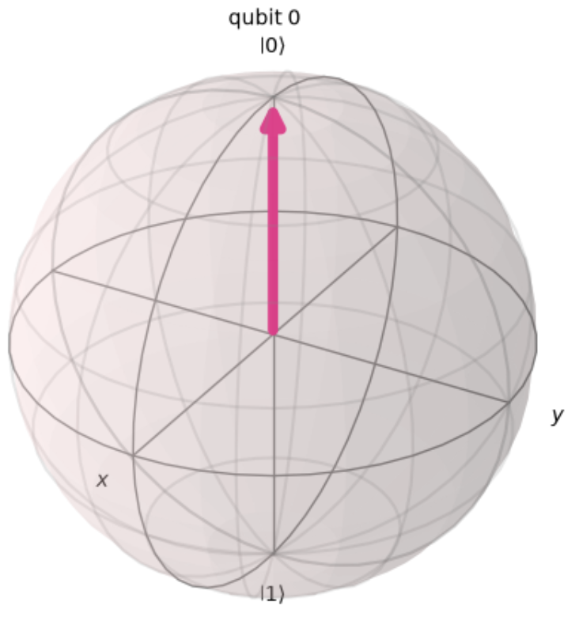
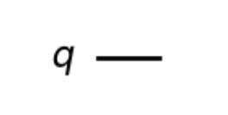
Demo: Single Qubit
In quantum computing, a qubit is the quantum mechanical analogue of the classical bit. However, what makes it special are it's inherent quantum mechanical properties of:
Superposition,
Entanglement, and
Interference.

Slide 37
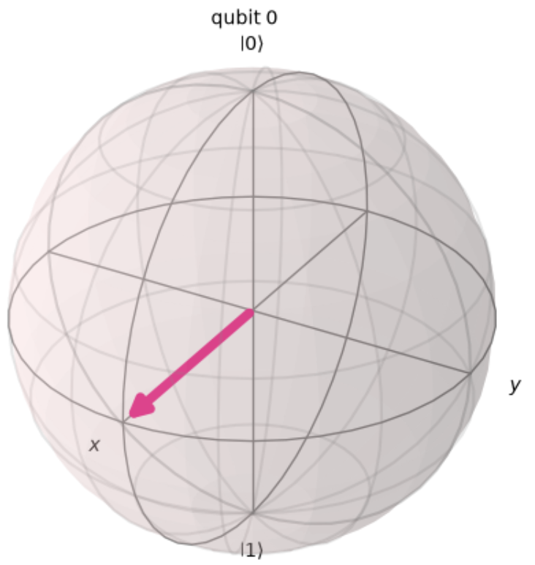
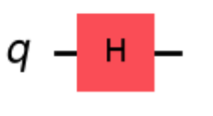
Demo: Superposition
A special feature of a qubit, is that it can exist in a quantum mechanical state known as superposition. A classical bit a coin flip can either end up landing heads or tails. A qubit on the other hand, is like the coin being flipped, suspended and spinning in the air, both heads and tails
simultaneously. i.e. it exists in a quantum state
that combines both possibilities
until measured.

Slide 38
Demo: Interference
Intuition would lead one to believe that two superpositions applied to the quantum state should give equal probability of meaning either 0 or 1. However, the two superpositions instead interfere constructively and destructive, resulting in the identity.
To put it more plainly, quantum algorithms achieve exponential speedup because the amplitudes interfere - not because quantum computer "try every answer concurrently".

Slide 39
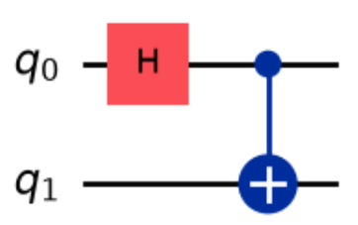
Demo: Two Qubit Entanglement
Once entangled, the two qubits act as a single quantum mechanical system.

Slide 40
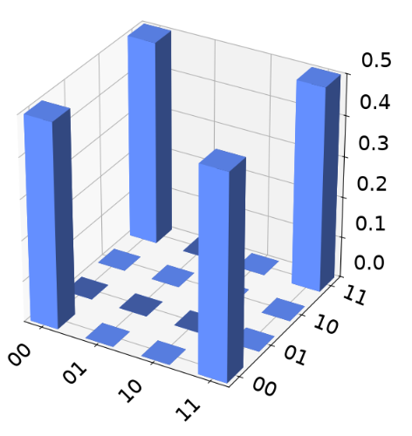
Demo: Coin Flips
Imagine flipping two coins 1000 times. Each time covering the coins so that you could not see whether either was heads or tails. The previous entanglement result, would be equivalent to: everytime any single coin is revealed to be either heads or tails, the other coin would also correspond exactly...

Slide 41

THANK YOU

