Slide 1


Scripting and Code Compilation
By Tebogo Diraditsile

Slide 2

What is a shell script?
A text file of commands the shell runs top-to-bottom
Anything you type in the terminal can go in a script
#!/bin/bash (shebang) → tells the system which interpreter to use

Slide 3
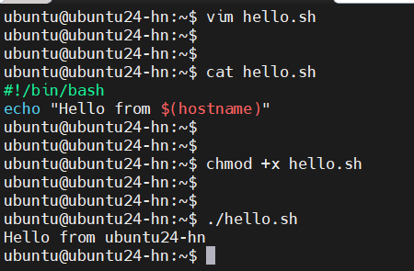
Basic Script

Slide 4
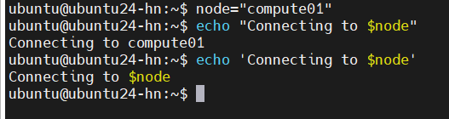
Scripting: Variables
name="cluster" (no spaces around =)
Use: $name or ${name}
"$var" (double quotes) vs '$var' (literal) — quoting matters

Slide 5
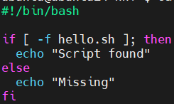
Scripting: Conditionals
if [ condition ]; then ... fi
Common tests: -f file exists, -d dir exists, -z empty string
Exit codes: 0 = success, non-zero = failure ($?)

Slide 6
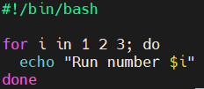
Scripting: Loops
Loop Through a List, Range of Numbers, Files in a Directory
Huge time-saver: run the same step over many files/nodes

Slide 7
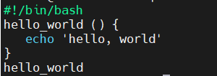
Scripting: Functions
Group reusable logic into functions

Slide 8
Why Scripting Matters
You'll never do things once on a cluster — you do them at scale
Scripts = automation + reproducibility

Slide 9
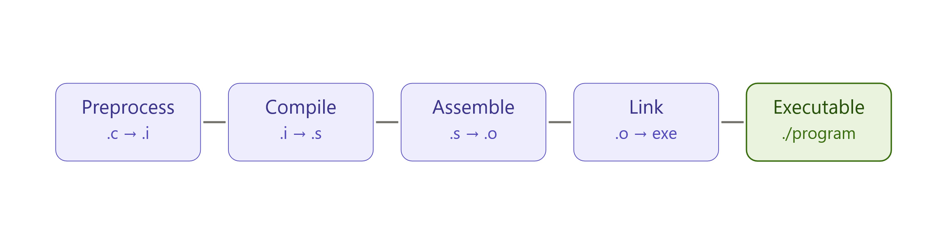
CODE COMPILATION
Source code is text; the CPU runs machine code
Compilation = the translation step

Slide 10
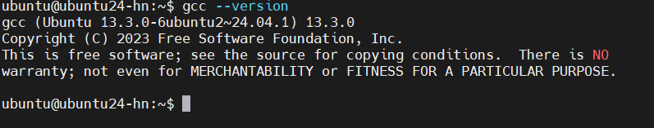
Compilers
GCC: gcc (C), g++ (C++), gfortran (Fortran)
MPI Wrappers: mpicc, mpicx, mpif7
On a cluster, the compiler is a module, not always the system default

Slide 11
Useful Compiler Flags
-Wall → turn on warnings (catch bugs early)
-g → debug symbols (for debuggers)
-O0 / -O2 / -O3 → optimisation levels
-march=native → tune for this CPU

Slide 12
Headers and Libraries (Linking)
-I/path → where to find header files (.h)
-L/path → where to find libraries
-lname → link library libname (e.g. -lm for math)

Slide 13
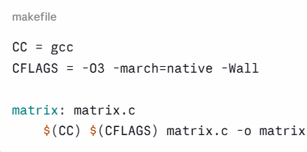
Multi-file builds & Makefiles
Real programs = many files; recompiling everything is slow
A Makefile rebuilds only what changed
make reads the rules and runs the compiler for you

Slide 14
Compilation pitfalls
undefined reference to ... → missing -l (library not linked)
fatal error: x.h: No such file → missing -I (header path)
Aggressive -O3 changing results → validate correctness, not just speed
Compilation = getting the fastest correct binary for this hardware

Slide 15
Scripting + Compilation Example
Live Demo or Pre-recorded Demo

Slide 16

THANK YOU

