Slide 1


Introduction To
Scripting
By Tebogo Diraditsile

Slide 2

What is a shell script?
A text file of commands the shell runs top-to-bottom
Anything you type in the terminal can go in a script
#!/bin/bash (shebang) → tells the system which interpreter to use

Slide 3
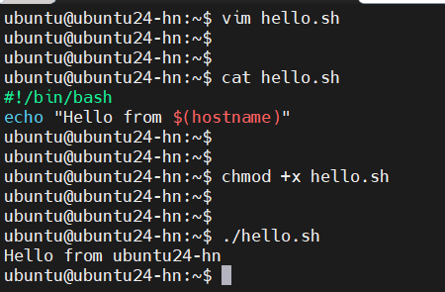
Basic Script

Slide 4
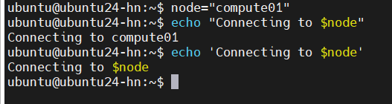
Scripting: Variables
name="cluster" (no spaces around =)
Use: $name or ${name}
"$var" (double quotes) vs '$var' (literal) — quoting matters

Slide 5
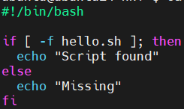
Scripting: Conditionals
if [ condition ]; then ... fi
Common tests: -f file exists, -d dir exists, -z empty string
Exit codes: 0 = success, non-zero = failure ($?)

Slide 6
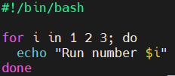
Scripting: Loops
Loop Through a List, Range of Numbers, Files in a Directory
Huge time-saver: run the same step over many files/nodes

Slide 7
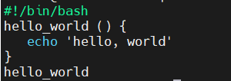
Scripting: Functions
Group reusable logic into functions

Slide 8
Why Scripting Matters
You'll never do things once on a cluster — you do them at scale
Scripts = automation + reproducibility

Slide 9
Example Script
Basic script that checks if you can SSH into a node

Slide 10

THANK YOU

