Slide 1

Parallel Computing
MPI & Threads
CHPC SCC 2026 | Selection Round
Many cooks, one meal

Slide 2

Today's Menu
Starter
The big idea: many hands on one job
First course
One kitchen, many cooks - threads (OpenMP)
Main
Many kitchens - ranks & messages (MPI)
The tricky bit
When parallel pays off - and when it doesn't
Dessert
Combining them, and cooking in a shared kitchen
Served before the HPL benchmarking session, where you'll taste it for real.

Slide 3
One Cook Can Only Chop So Fast
A single cook with 10,000 onions is in for a long night.
Parallel computing is simply this: put many cooks (cores) on the job at the same time.
One cook
10,000 onions to chop...

Slide 4
Why This Is the Whole Point of a Cluster
Last session you met the hardware - cores inside a node, nodes inside a cluster. But all those cores only help if your program splits the work across them.
1 cook
10 hours
100 cooks
~6 minutes
work done one piece at a time
work shared, done at once

Slide 5
The Mental Model: A Kitchen
The kitchen
A cook
= one core: the worker that does the cooking
The kitchen
= one node: cooks share its counters & fridge
The recipe
= your program: the steps everyone follows
shared counter + fridge
Shared counter
= shared memory: anyone reaches the same food
Hold onto this picture - everything today builds on it.

Slide 6
Two Ways to Add Cooking Power
Start: one kitchen
Add cooks to THIS kitchen
More workers sharing one memory.
= Threads (OpenMP)
Open MORE kitchens (processes)
Each a separate process with its own memory.
= Ranks (MPI)

Slide 7
Threads: Many Cooks, One Kitchen
One kitchen = one node (OpenMP)
All cooks share the same kitchen:
one fridge, one set of counters - shared memory.
Coordinating is easy: just talk across the counter (fast).
The limit: one kitchen only holds so many cooks - you can't grow past a single node.
shared counter + fridge = shared memory
OpenMP = how you put more cooks into one kitchen.

Slide 8
Sharing Is Fast - But Watch the Collisions
The upside
One pot, two cooks
No copying - everyone reaches the same ingredients
Coordination is instant - just talk across the counter
The catch
Two cooks grab the same pot at once = a clash (race condition)
Fix: take turns (a lock) - but too much turn-taking slows everyone
Both reach for the same pot - who wins?

Slide 9
A Taste of OpenMP
Tell the compiler: 'split this loop of 10,000 onions across the cooks.'
One line turns one cook into eight.
The cooks share the same arrays - no copying.
// chop every onion - hand them out to the cooks
#pragma omp parallel for
for (i = 0; i < 10000; i++)
chop(onion[i]);
$ export OMP_NUM_THREADS=8 # 8 cooks
The dedicated OpenMP session goes deeper - here we just want the picture.

Slide 10
Ranks: Separate Processes (MPI)
A rank is a process, not a node. When one node is full, start more ranks on other nodes — each with its own separate memory.
Rank 0 (a process)
Rank 1 (a process)
Rank 2 (a process)
its own memory
its own memory
its own memory
Ranks can’t read each other’s memory — the only way they share anything is by sending messages.

Slide 11
A Rank Isn't Always a Whole Machine
A rank is a process, not necessarily a whole node.
You can run several ranks on one machine - like running two smaller kitchens inside one big building.
On big servers, one rank per section often works best.
One machine (node)
rank 0
rank 1
From the competition floor: the 'one rank per section' idea (NUMA) is a rabbit hole - the HPL session opens it up. For now: ranks are processes, and placement matters.

Slide 12
Messages: The Runners Between Kitchens
Kitchen A
Kitchen B
everyone
broadcast
tell all kitchens at once
Point-to-point: one runner, one kitchen to another (send / receive).
Collectives: tell everyone (broadcast) or gather from everyone (reduce).
From the competition floor: every runner costs time. The whole game across nodes is doing useful cooking between messages - not waiting on runners.

Slide 13
A Taste of MPI
Each rank gets a slice of the onions, cooks it, then they combine results.
4 kitchens, 4 ranks - each owns its slice.
They message each other to share edges and totals.
$ mpirun -np 4 ./chop_onions
rank 0: onions 0 - 2499
rank 1: onions 2500 - 4999
rank 2: onions 5000 - 7499
rank 3: onions 7500 - 9999
You'll compile and launch real MPI code in the compilation & HPL sessions.

Slide 14
Threads vs Ranks, Side by Side
Ranks: many kitchens
Threads: one kitchen
rank 0
rank 1
shared fridge
Memory
shared fridge
separate fridges
Coordinate by
talking across counter
sending runners
Scope
within one node
across many nodes
You write it with
OpenMP
MPI

Slide 15
When Parallel Works Beautifully
If every onion is independent, just hand them out.
No cook waits on another. No runners needed.
10 cooks ≈ 10x faster.
We call this "embarrassingly parallel" - the easy, happy case.

Slide 16
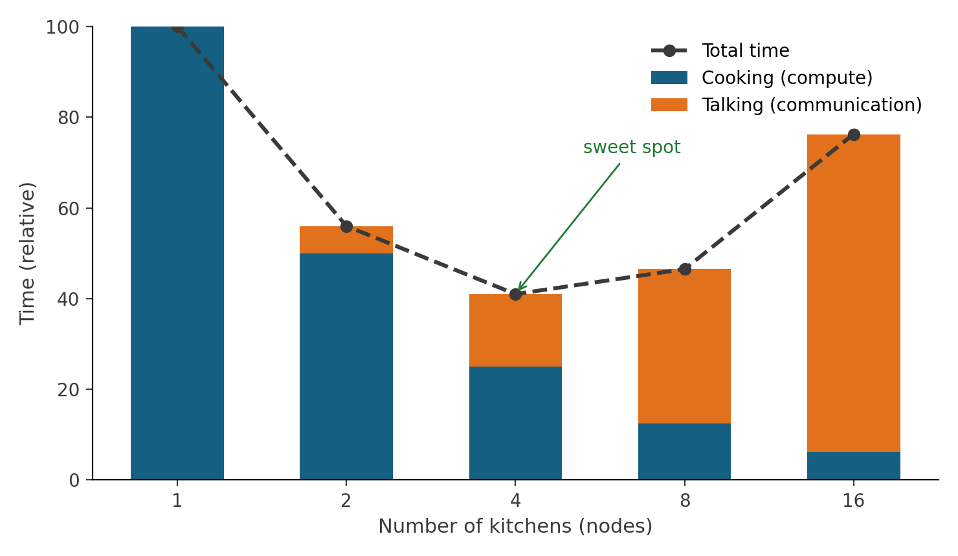
Trap 1: Too Much Talking
Add kitchens and cooking time drops - but talking grows.
Past the sweet spot, more kitchens make the meal slower.
From the competition floor: on a slow 1GbE network in my HPL work, talking dominated - fewer, bigger messages and fewer ranks won. The network decides the sweet spot.

Slide 17
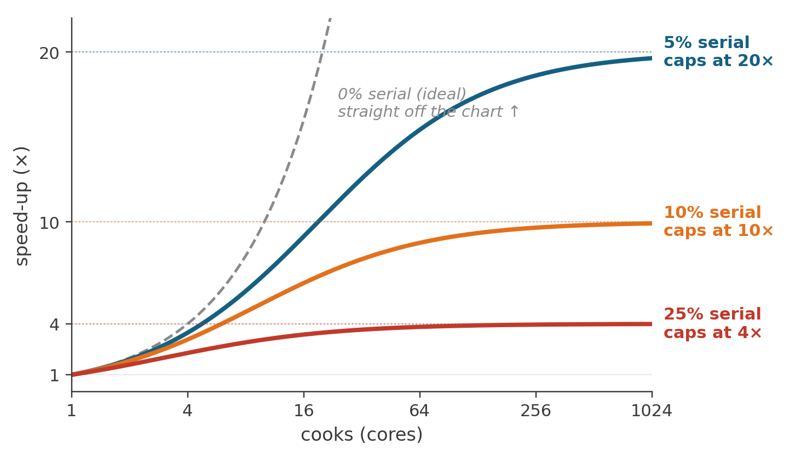
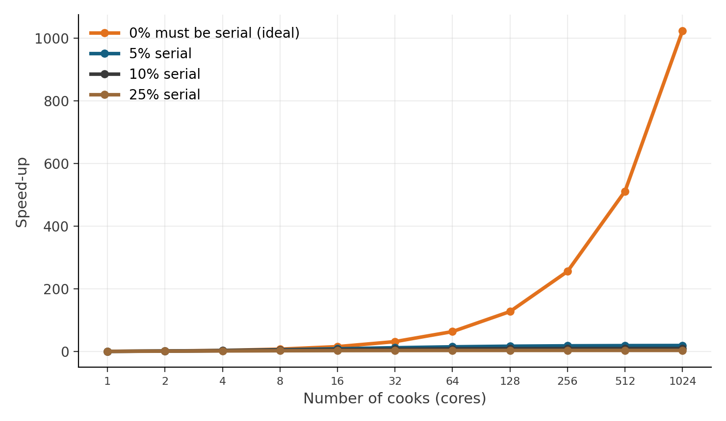
Trap 2: The Recipe's Bottleneck
Some steps must be done by one cook: mix before you bake; one oven.
That serial part caps your speed-up - no matter how many cooks.
If 10% is serial, 100 cooks give only ~9x - never 100x.
Amdahl's Law: find the serial step - and shrink it.

Slide 18
The Pro Move: Use Both
Many cooks in each of a few kitchens = threads inside nodes + MPI across nodes (hybrid).
Kitchen 1 (1 rank)
Kitchen 2 (1 rank)
shared fridge
shared fridge
Fewer kitchens = fewer runners, but each kitchen fully staffed. Often the winning setup.
From the competition floor: this hybrid approach is exactly what the HPL session will demonstrate live.

Slide 19
You're Cooking in a Rented Kitchen
On Sebowa / OpenStack you get a virtual machine.
Your 'cooks' are vCPUs the hypervisor hands you - and the real kitchen may be shared with other teams.
So 8 vCPUs ≠ 8 guaranteed dedicated cores, and pinning is fuzzier than on your own cluster.
Physical machine (shared)
hypervisor (shares it out)
your VM
another team
Measure, don't assume - benchmark your VM.

Slide 20
Where You'll Actually Turn These Knobs
Everything today becomes a dial you tune in benchmarking:
1
Cooks per kitchen
threads per rank (OMP_NUM_THREADS)
2
How many kitchens
number of ranks (mpirun -np)
3
How the runners move
message pattern & size
4
Where cooks stand
binding / placement on the node
Up next - HPL Benchmarking: your HPL presenter will demonstrate these live on a real run.

Slide 21
Ranks vs Threads, Properly Defined
Two different kinds of worker — and the whole difference is memory.
AN MPI RANK = one kitchen’s crew (a process)
AN OPENMP THREAD = one cook
A full process — its own copy of the program, launched by mpirun.
A lightweight worker inside one rank — forked when the recipe hits a parallel region.
Allocates its own memory — its own fridge: its own slice of the matrix. No other rank can reach in.
Shares the rank’s memory — one fridge, many hands: same arrays, nothing copied, nothing sent.
Lives on any node — the only way ranks share anything is by sending messages over the network.
Never leaves the node — threads exist only inside their process; they cannot talk across kitchens.
Ranks own their memory and talk over the network. Threads share memory — and never leave the node.

Slide 22
Who Puts the Result Together?
Threads live in bursts: they fork to compute, then join back into one. In between, each rank speaks with one voice.
fork: all threads computing
rank 0 gathers &
reports the result
join: thread 0 alone
handles the MPI calls
Compute: all threads compute at once — in HPL, that is the BLAS library chewing through DGEMM.
Communicate: only the master thread (thread 0) of each rank sends and receives. The threads join before any message is sent.
Finish: ranks combine results with a reduce, and rank 0 assembles and prints the answer — in HPL, the Gflop/s line and the residual check.
So: thread 0 of each rank does the talking — and rank 0 of the whole job does the telling.

Slide 23
Building One Binary That Speaks Both
MPI is a library you link. OpenMP is inside the compiler — you switch it on with a flag.
$ mpicc -fopenmp chop_onions.c -o chop
wrapper links MPI flag turns threads on
Where do HPL’s threads live?
Inside the BLAS. HPL calls it; the library forks the threads.
If the BLAS is not threaded, OMP_NUM_THREADS does nothing.
For HPL, the same two ideas live in Make.<arch>:
CC = mpicc # MPI baked in by the wrapper
CCFLAGS = $(HPL_DEFS) -O3 -fopenmp # OpenMP switched on
LAlib = .../libopenblas.a
# ^ the BLAS itself built threaded: make USE_OPENMP=1
Intel stack? Same recipe, different spelling: mpiicc, -qopenmp, and MKL’s threaded layer.

Slide 24
Four Dials: The OMP Environment Variables
Environment variables set before the run — they tell every rank how many threads to run, and where.
OMP_NUM_THREADS=4
Threads per rank. How many threads each rank forks. The one dial you must always set.
OMP_PLACES=cores
Where threads are allowed to sit. One core each. (Other rooms: sockets, threads.)
OMP_PROC_BIND=close
Sit together — and stay put. Pack the team next to thread 0 (shares cache). spread spaces them out (more memory bandwidth).
OMP_DYNAMIC=false
No quiet under-staffing. Forbid the runtime from shrinking the team below what you asked for.
Using Intel’s MKL as your BLAS? It ships its own copy of the dial — set MKL_NUM_THREADS (and MKL_DYNAMIC=FALSE) to match.

Slide 25
Pinning: Don’t Let Processes Wander
Left alone, the OS shuffles processes between cores — and every shuffle throws away that core’s warmed-up data (the cache). Binding glues everyone down.
--bind-to core
--bind-to socket
socket
socket
rank 0
rank 1
rank 2
rank 3
one rank — all 4 threads own it
Each rank glued to one core.
The pure-MPI setup (1 thread per rank).
Each rank owns a whole socket.
Room for its 4 threads.
1 thread per rank → bind to core. Threads per rank → bind to socket.
--report-bindings
trust, but verify: prints where every rank landed.

Slide 26
Anatomy of a Launch Command
Same ideas, other spellings
$ mpirun \
--hostfile hosts.hpl \ # which nodes to run on
--map-by ppr:4:node \ # place 4 ranks on each node
--bind-to core \ # glue each rank to a core
--report-bindings \ # print the seating plan
-x OMP_NUM_THREADS \ # send that dial to every rank
-np 24 ./xhpl # total ranks, across all nodes
-n 24
= -np 24
-ppn 4
= ppr:4:node
-genv VAR val
= -x VAR
(the mpiexec / MPICH / Intel MPI dialect — pick one and be consistent)
The knobs you retune between runs: ppr:N:node (ranks per node), -np (total ranks), --bind-to (how much room each rank gets).
Seen stdbuf -oL ... | tee -a out.txt wrapped around this? Just logging plumbing — live output, saved to a file. Not MPI.

Slide 27
Staffing Six Nodes — and Your P × Q
Say you have 6 nodes × 4 cores = 24 cores. Golden rule: ranks × threads per rank = cores.
Pure MPI — 24 ranks × 1 thread
Hybrid — 6 ranks × 4 threads
export OMP_NUM_THREADS=1
mpirun --map-by ppr:4:node \
--bind-to core \
-np 24 ./xhpl
export OMP_NUM_THREADS=4
mpirun --map-by ppr:1:node \
--bind-to socket \
-np 6 ./xhpl
24 ranks × 1 thread = 24 cores
6 ranks × 4 threads = 24 cores
HPL.dat grid: P × Q = 4 × 6
HPL.dat grid: P × Q = 2 × 3
HPL deals the matrix onto a P × Q grid of ranks — so P × Q must equal -np. Change the rank count → rewrite P and Q (keep P ≤ Q).
From the competition floor: same 24 cores either way — on my cluster, the slow network picked the winner. Measure both.

Slide 28
Common Pitfalls
1
Throwing cooks at a serial recipe
Amdahl caps you - parallelise the right part.
2
Chatty MPI: runners everywhere
Too many small messages drown the cooking.
3
Oversubscribing the rented kitchen
More threads than real cores = cooks tripping up.
4
Expecting 2 cooks = exactly 2x
Overheads are real; measure the actual speed-up.
5
Forgetting cooks can collide
Shared data needs turns (locks) or it corrupts.

Slide 29
The Recipe to Remember
Parallel Computing - in five lines
Threads
many cooks, one kitchen - shared memory, within a node (OpenMP).
Ranks
many kitchens - separate memory, across nodes, via messages (MPI).
Great when
the work is independent: hand it out, near-perfect speed-up.
Stalls when
too much talking (communication) or a serial step (Amdahl).
On a VM
your cooks are shared vCPUs - measure, don't assume.

Slide 30
What's Coming Next | Q&A
HPL Benchmarking + Demo
Tune threads, ranks and messages on a real run - live.
Compilation & Environments
Build the MPI + OpenMP code you just met.
Application Optimisation
Find the serial step and the chatty messages, and fix them.
Questions?
Many cooks, one meal.

Slide 31

Parallel Computing - CHPC SCC 2026

