Slide 1


OpenMX
CHPC SCC 2026 | Live Session | Demo

Slide 2


What is OpenMX
OpenMX is an open-source quantum chemistry and materials simulation software package that uses density functional theory (DFT) with localized basis functions to study the electronic structure of atoms, molecules, and solids.
Notes:
Material science
computational materials science and condensed matter physics.

Slide 3
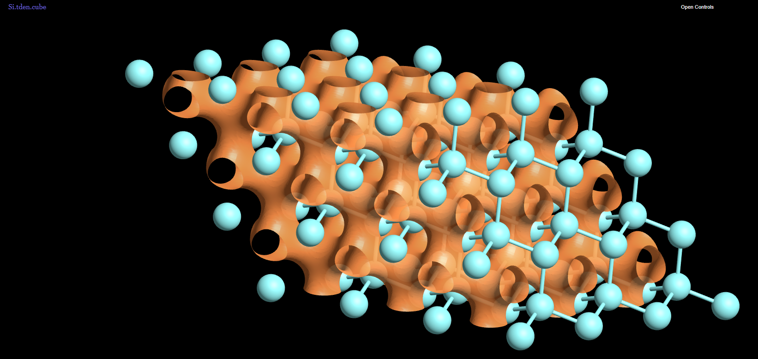
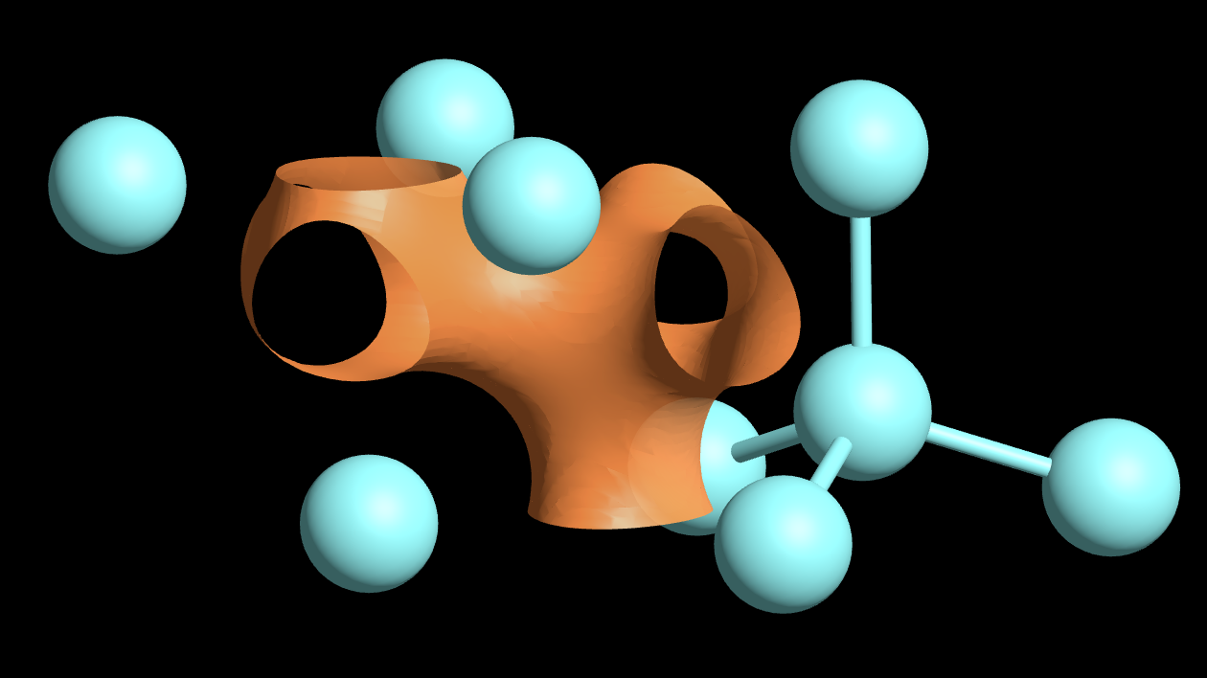
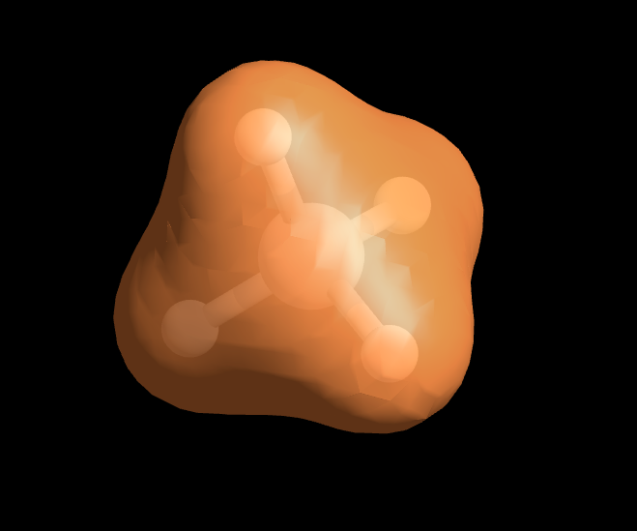
Goals
Silicon
Methane
Notes:
1, Methane molecule
2, silicon cluster but with 54 atoms
[54-atom silicon supercell.] bulk crystalline silicon in the diamond cubic structure
the 54 Si atoms of your supercell, arranged in silicon's characteristic diamond cubic lattice (each Si tetrahedrally bonded to 4 neighbors — you can see that tetrahedral bonding pattern clearly on the right side of the image
Orange "pretzel" surface = an isosurface, of charge/electron density
charge-density isosurface drawn at a fairly high cutoff value around clustered atoms
Polydimethylsiloxane

Slide 4
Demo time
Notes:
1, Build intel built
2, run Methane (see output) – remember time
3, Build mix
4, run Methane – remember time
5, Build complex example
6, run Methane – remember time
-Wno-error=incompatible-pointer-types

Slide 5
Expected results
Notes:
Material science
computational materials science and condensed matter physics.

Slide 6

THANK YOU

