Slide 1


HPC Networks & SSH
CHPC SCC 2026 | Live Session | Demo

Slide 2

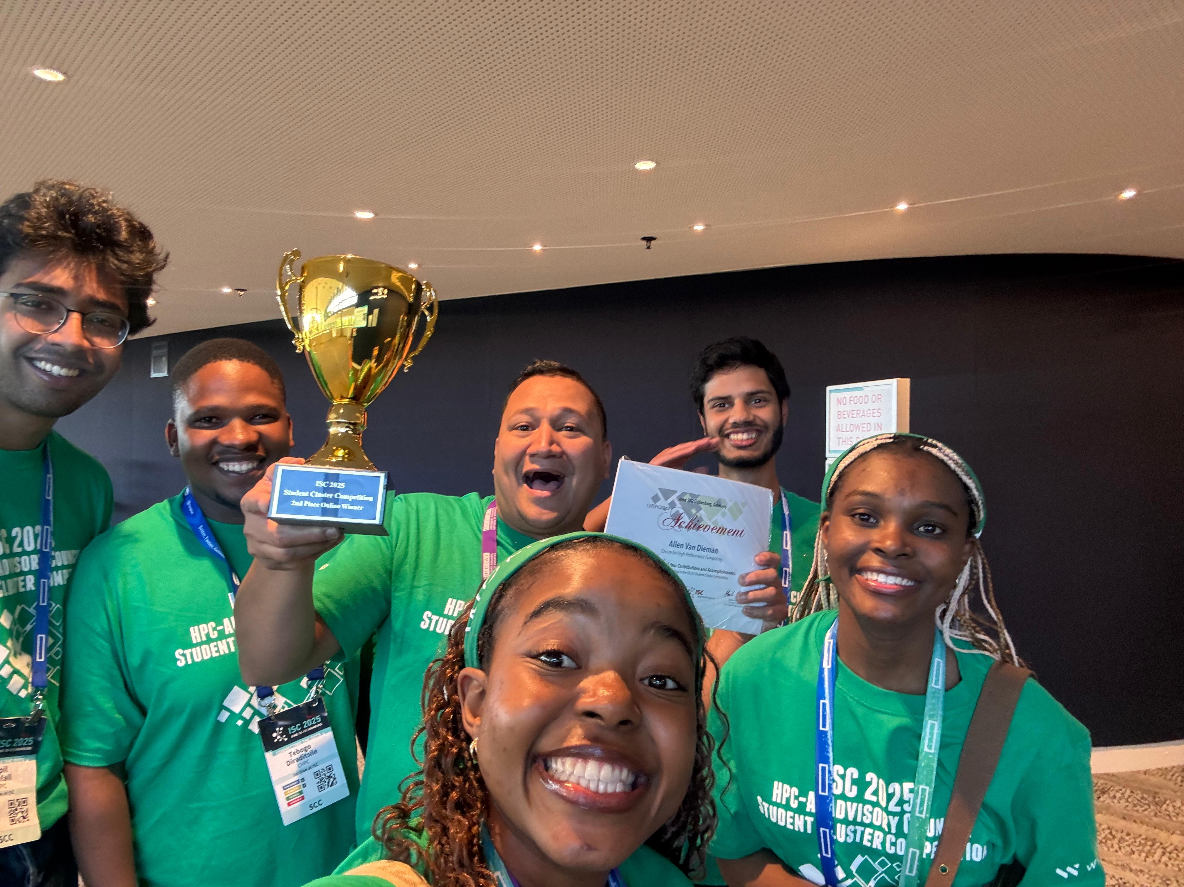
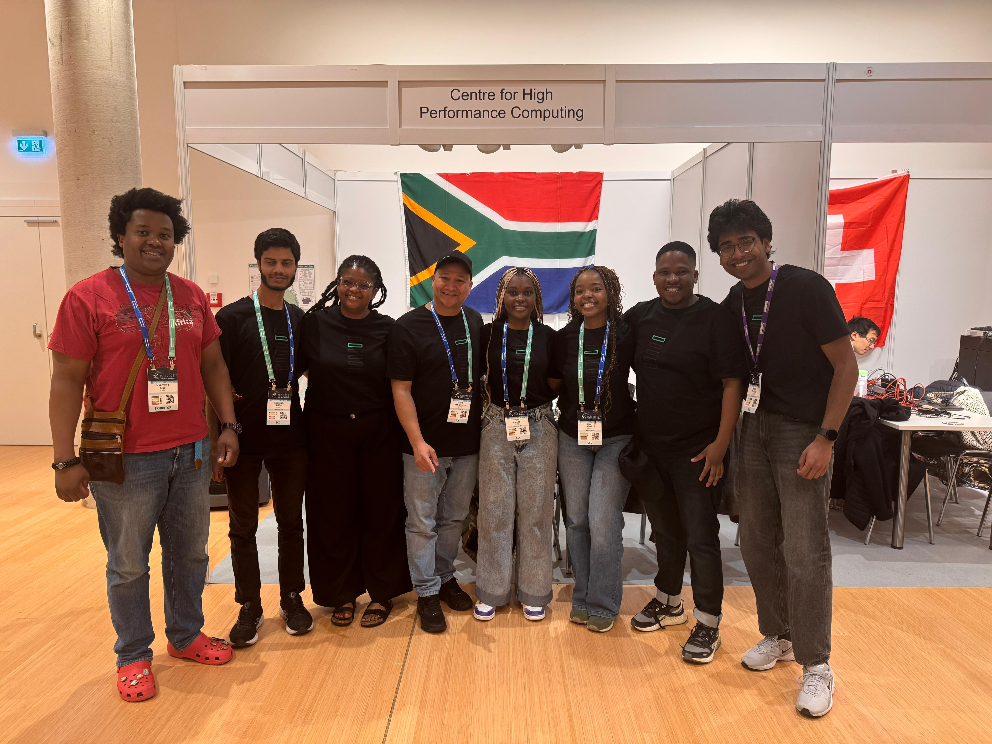
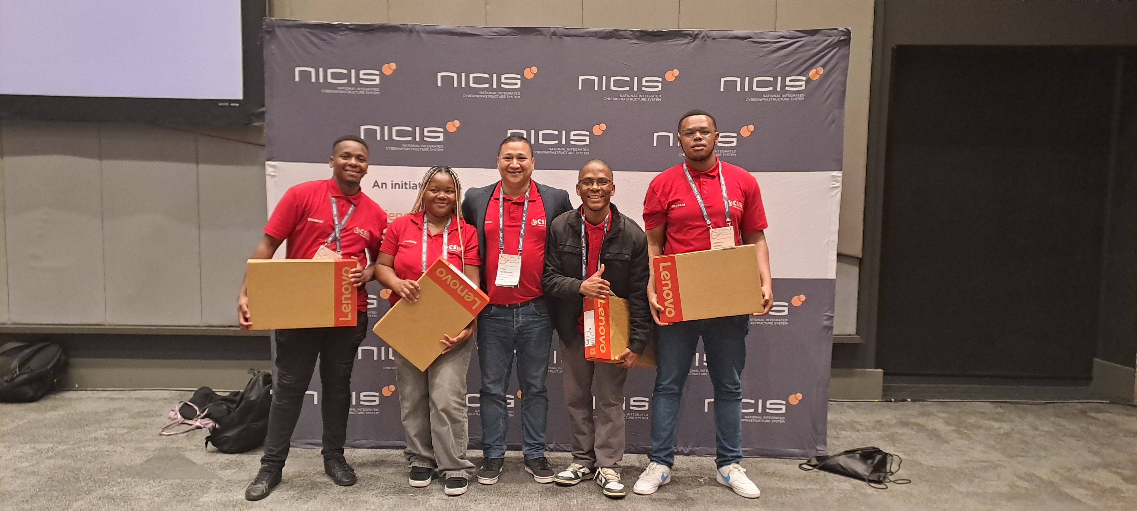
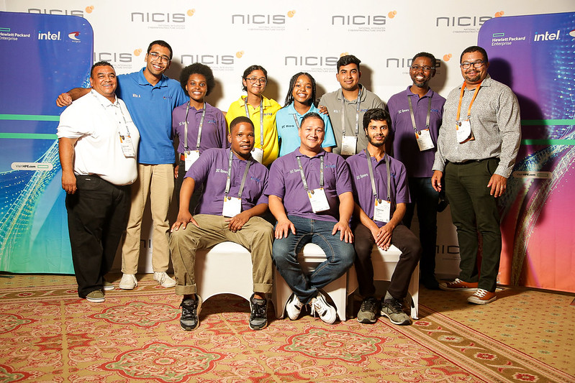
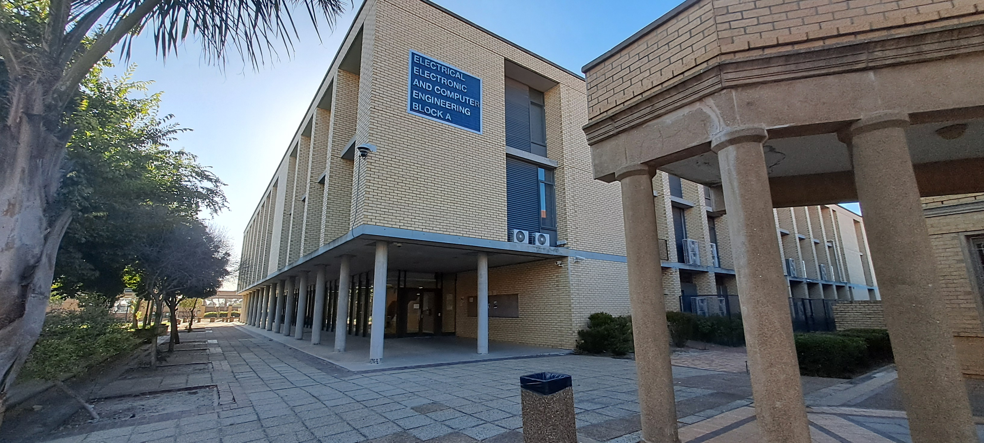

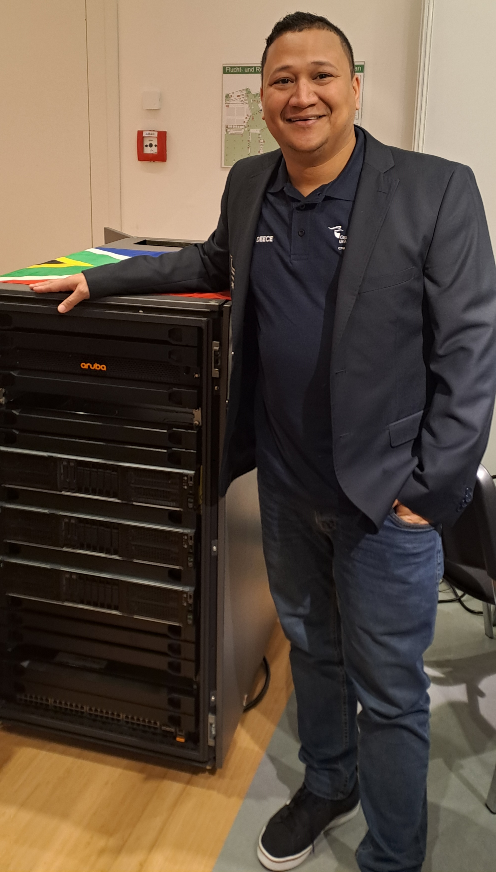

Introduction
Notes:
About myself:
My name is Allen Van Dieman
I currently a student doing Computer Engineering at CPUT
History in HPC: (SPACE)
I participated in SCC in 2024 with this team , we got 1st place (SPACE)
Our team got 4 additional members for ISC (SPACE) and this is the team that competed in ISC (SPACE)
Team SA got 2nd place at ISC (SPACE)
I also mentored a team in 2025 that achieved 2nd place

Slide 3
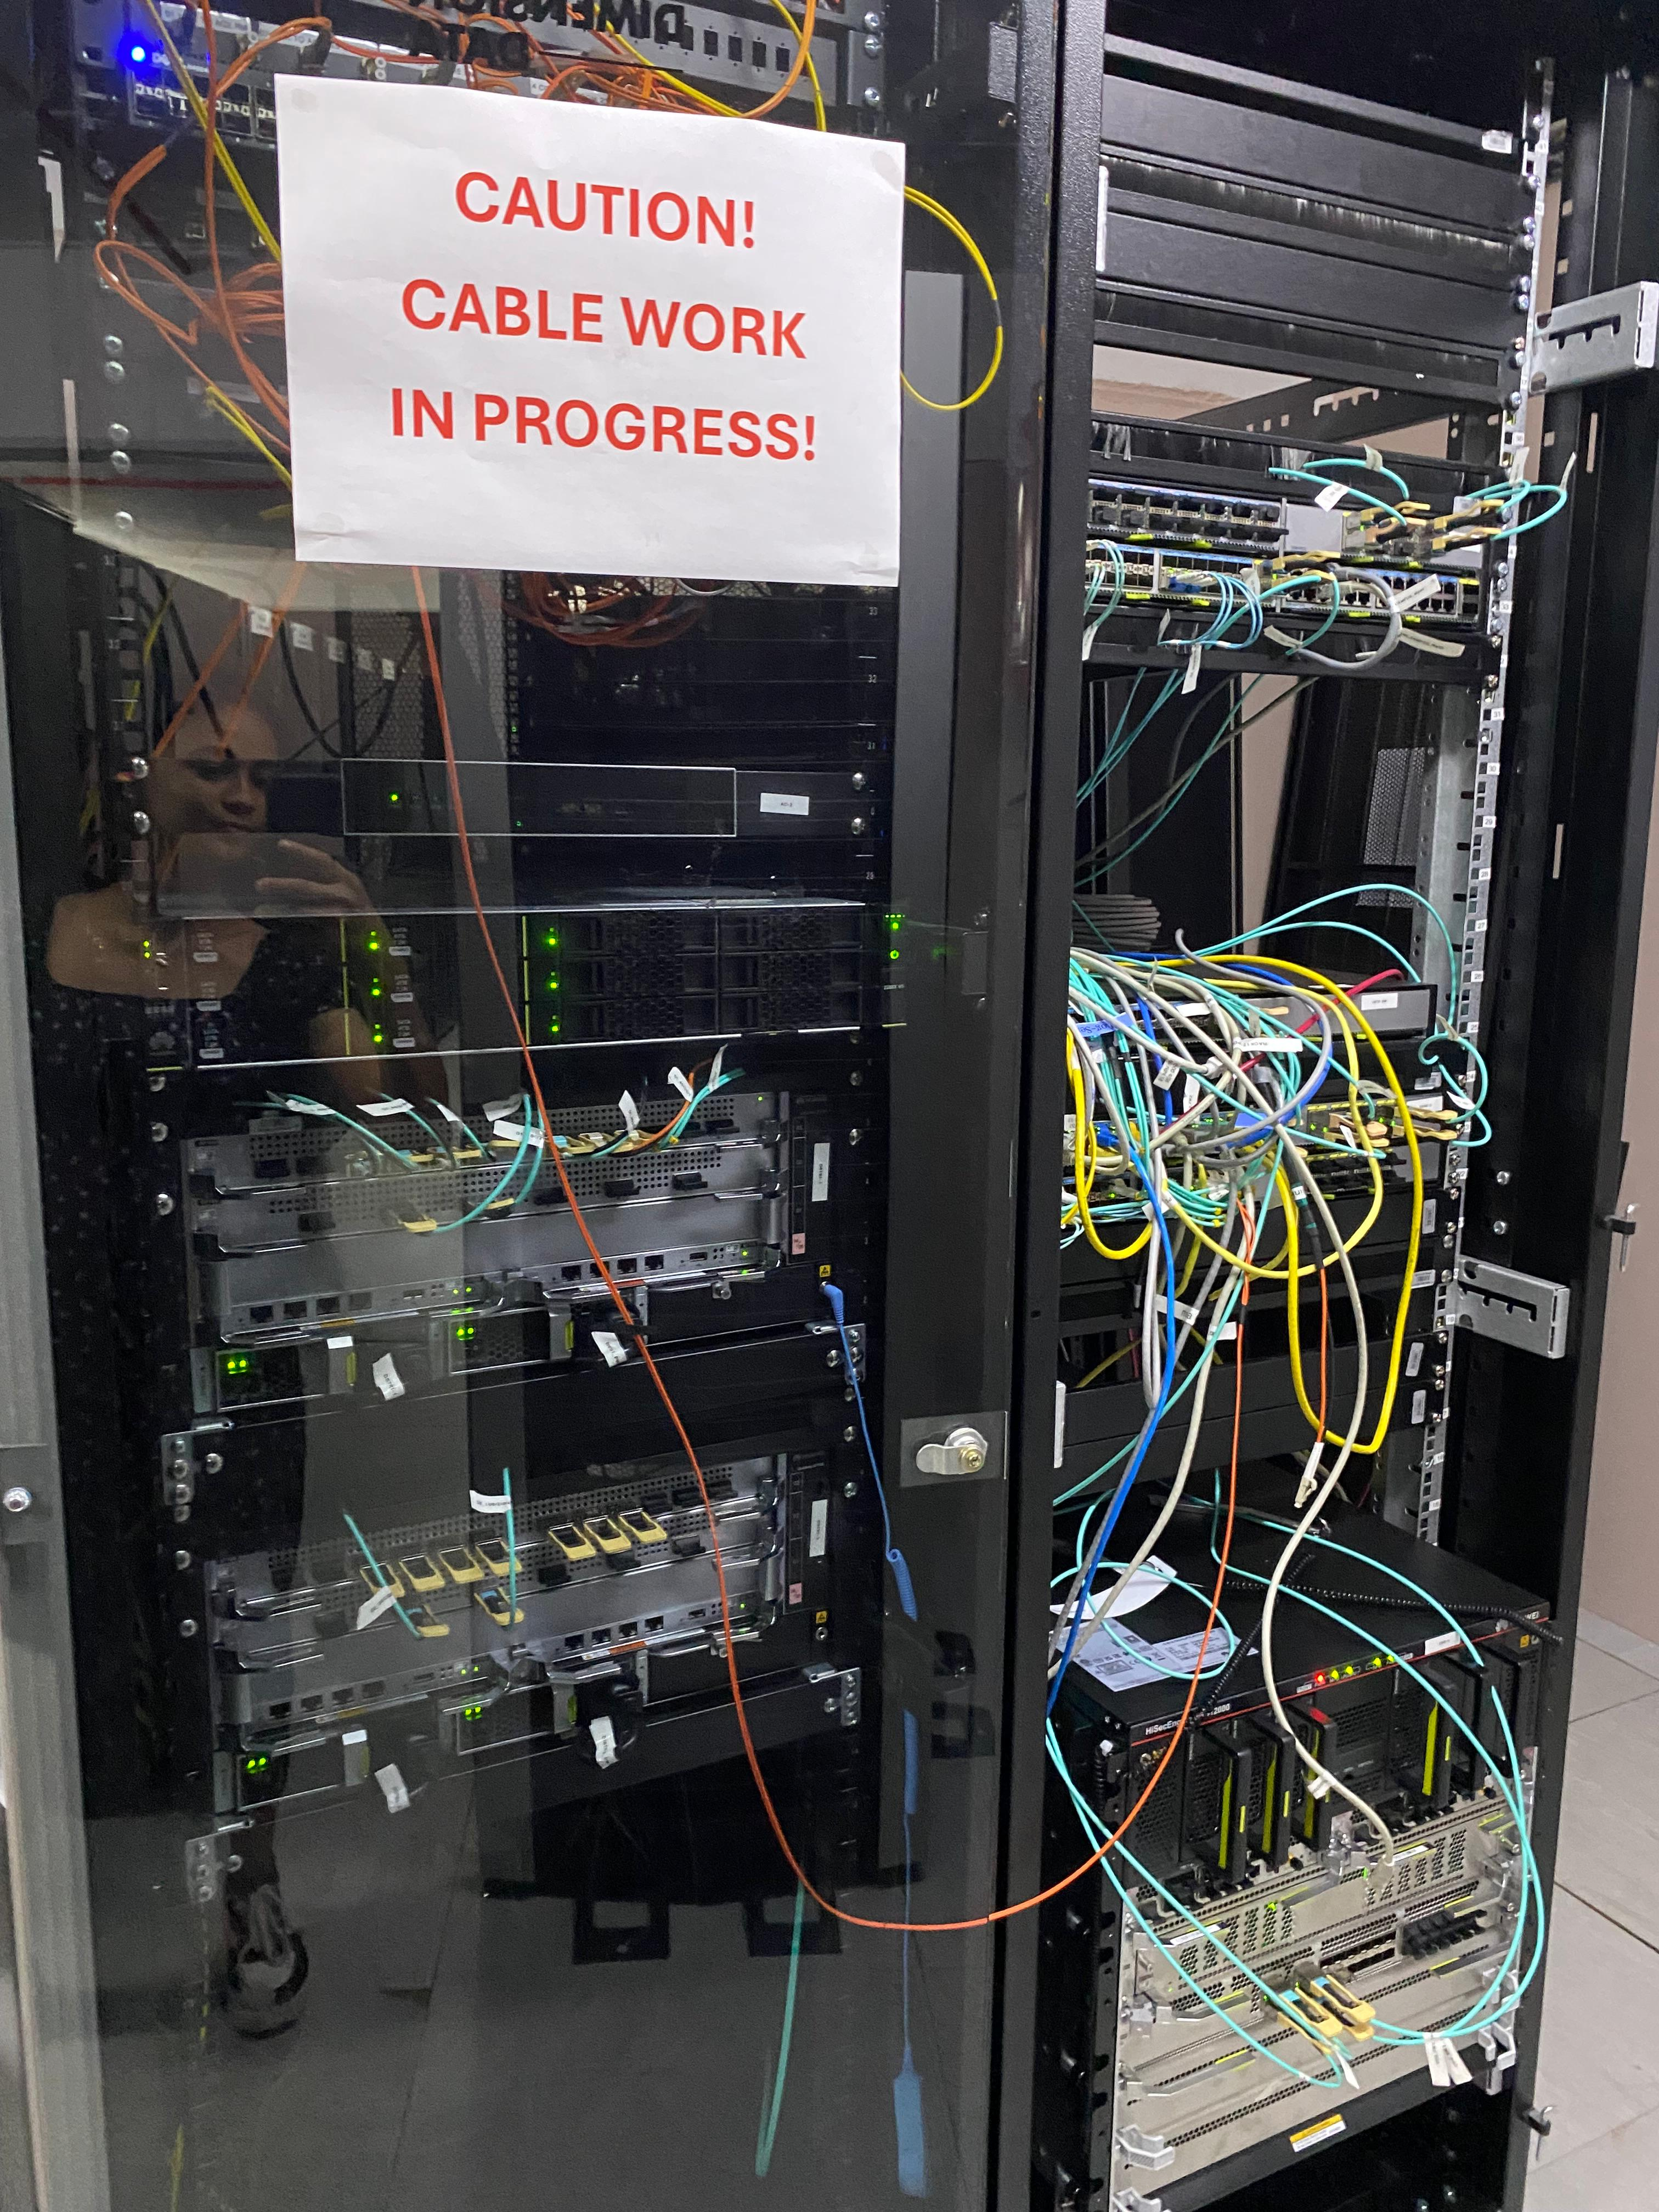
HPC Networks
State of HPC networks
Network Topologies
What you will use
Networking basic’s
Notes:
Sub topics

Slide 4
State of HPC Networks
What do we know
Ethernet used to be 10 ~ 100 Mb | That’s about average fiber speed
Ethernet 1Gb (standard)
HPC pushed ethernet 10Gb ~ 40Gb
New HPC ethernet and IB 100Gb up to
800Gb
Notes:
Ethernet used to be 10 ~ 100 Mb | That’s about average fiber speed
Ethernet 1Gb (standard)
HPC ethernet 10Gb ~ 40Gb
IB 100Gb up to 800Gb
New HPC ethernet 100Gb up to 800Gb

Slide 5
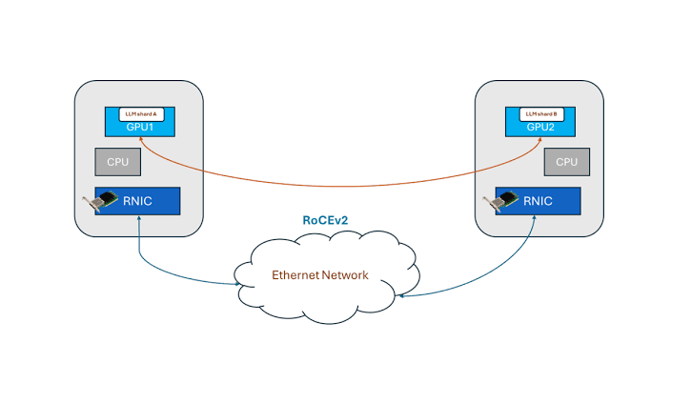
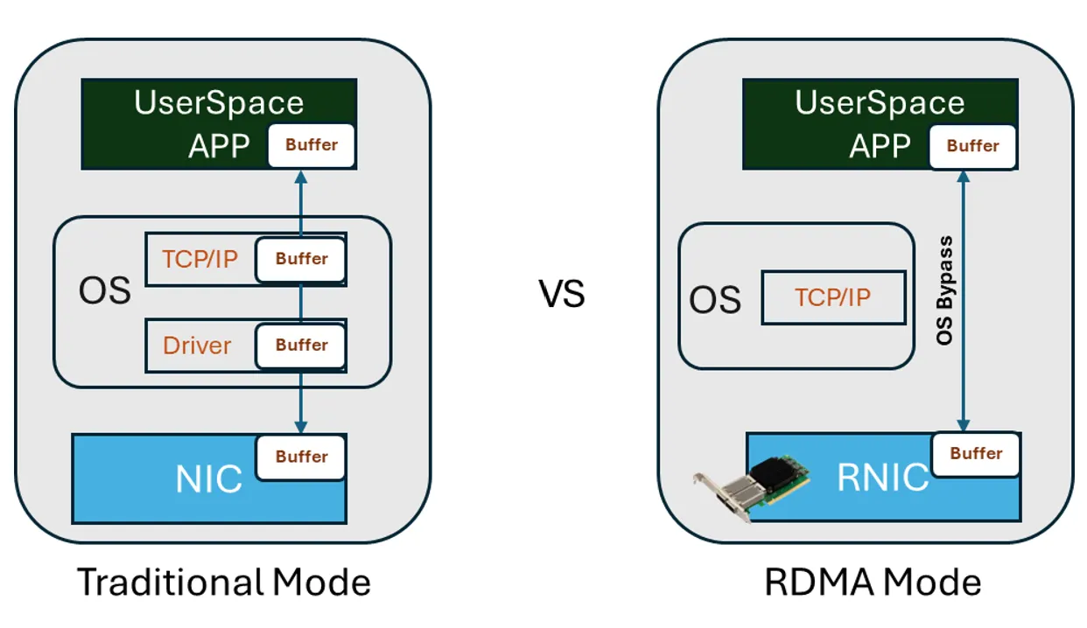
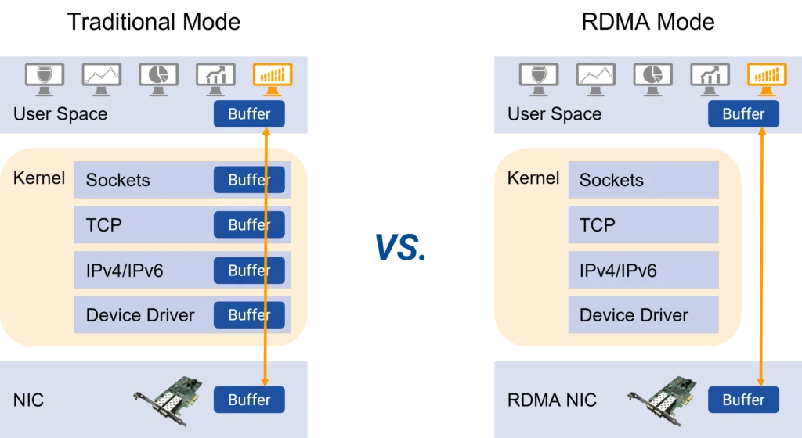
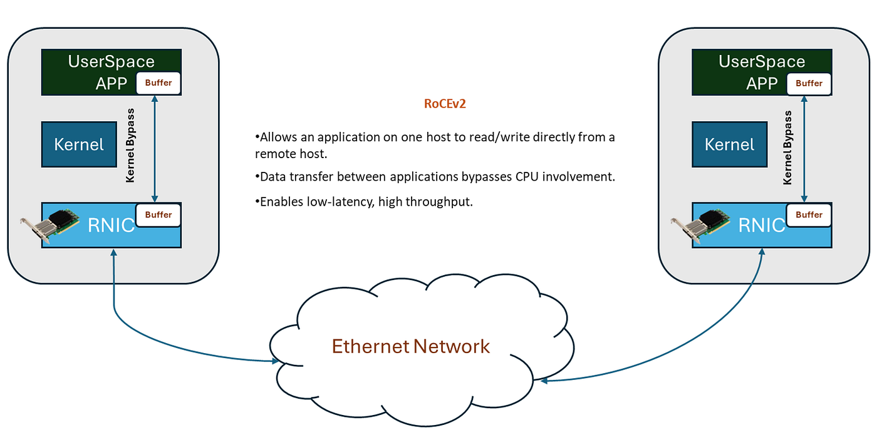
State of HPC Networks
Let’s discuss
InfiniBand (IB)
Vs
RoCE
vs
Ethernet
Notes:
InfiniBand (IB) -> RDMA (Remote Direct Memory Access)
allows computers to transfer data directly to the memory of another server without taxing the host CPU
Ethernet with RoCE
RDMA over Converged Ethernet

Slide 6
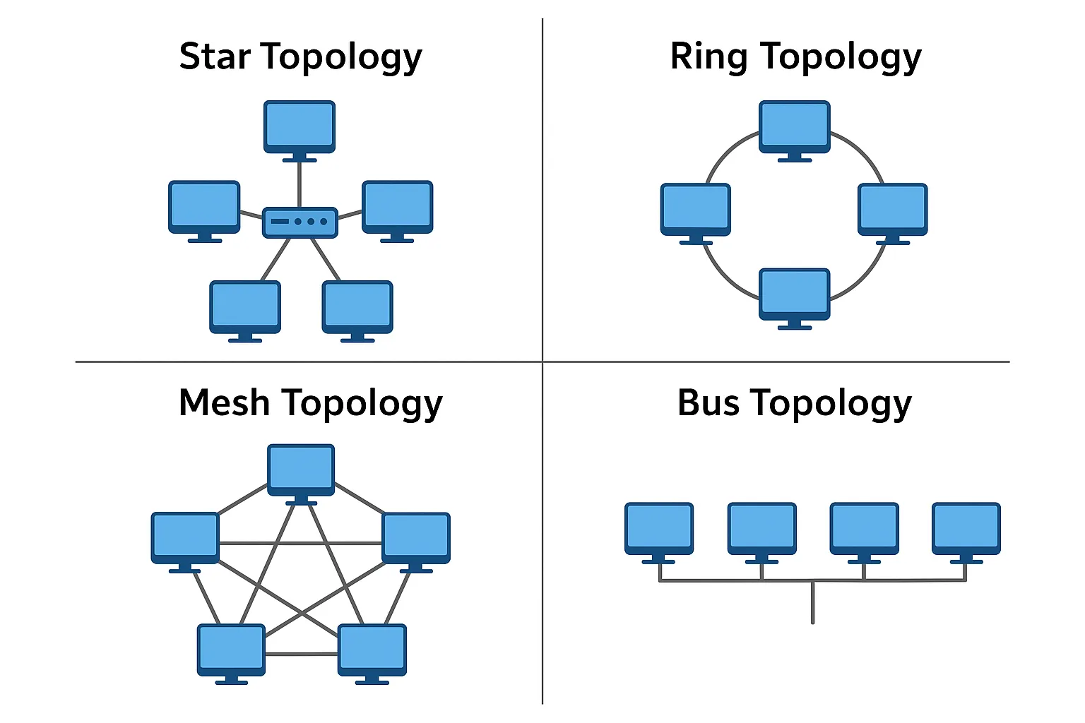
Networks Topologies

Slide 7
HPC Networks
What you will use
Networking basic’s
Networks and subnetting?
CIDR (Classless Inter-Domain Routing)?

Slide 8
SSH
What is SSH - Secure Shell
Uses TCP port 22
Remote Administration
Command Execution
Secure File Transfer
Port Forwarding (Tunneling)

Slide 9
SSH
What does SSH need to work
3 Things
USER , Destination , Authentication
ssh username@ip_address
Password
Notes:
DEMO!!
Show login using password

Slide 10
SSH Authentication
SSH Keypair
ssh-keygen –t ed25519
Public vs Private key
Notes:
DEMO!!
Show key creation
Remember this analogy
My key is private in my pocket, I keep it on me private
My lock is public, everyone can see it, but cant enter my house without my key

Slide 11
Key pair
Notes:
DEMO!!
Now lets say we have 2 people and few houses
1, This is my house, Let put a lock on it. (space)
Now who can access is?
What if I want to give red access to my house?
I add red lock (space)
Let take that lock off my house (space)
2, Lets add more locks (space)
Let say this white house over here we don’t care about it.
We want to give red access, can I give red my key? (space)
Let take my key away. (space) [WE never give our private keys out!!]
What should we do instead? (space) add its lock [public key]
3, This heart house, who can access this house? [nobody]
Lets add a key (space) who can access this house now?
-----------
Lastly (SPACE)
If a computer has multiple users
Locks can be added to each user (space)
And if we need someone to have access to a specific user (space) we can add its private key

Slide 12

THANK YOU

