Slide 1


File Systems
CHPC SCC 2026 Selection Round | Pre-recorded Session​

Slide 2



Introduction
Allen Van Dieman
BEngTech Computer Engineering
Department of Electrical, Electronic and Computer Engineering
CPUT
Cape Town
South Africa

Slide 3

Linux File Systems
Conventional Computer data stored as binary
A File is a collection of related data stored as binary digits
In Linux everything is a File
Hardware devices
Processes
Communication Sockets
Directories

Slide 4
Linux File Systems
Think encryption and compression
Encryption can influence performance
Compression can influence max file size
XFS (Best for Large Files and High Throughput)
Ext4 (Best All-Rounder and Low Overhead)
ZFS (Best for Multi-Drive NVMe/SSD Pools)
Notes:
Ext4 for boot
Rocky use XFS for home and root

Slide 5
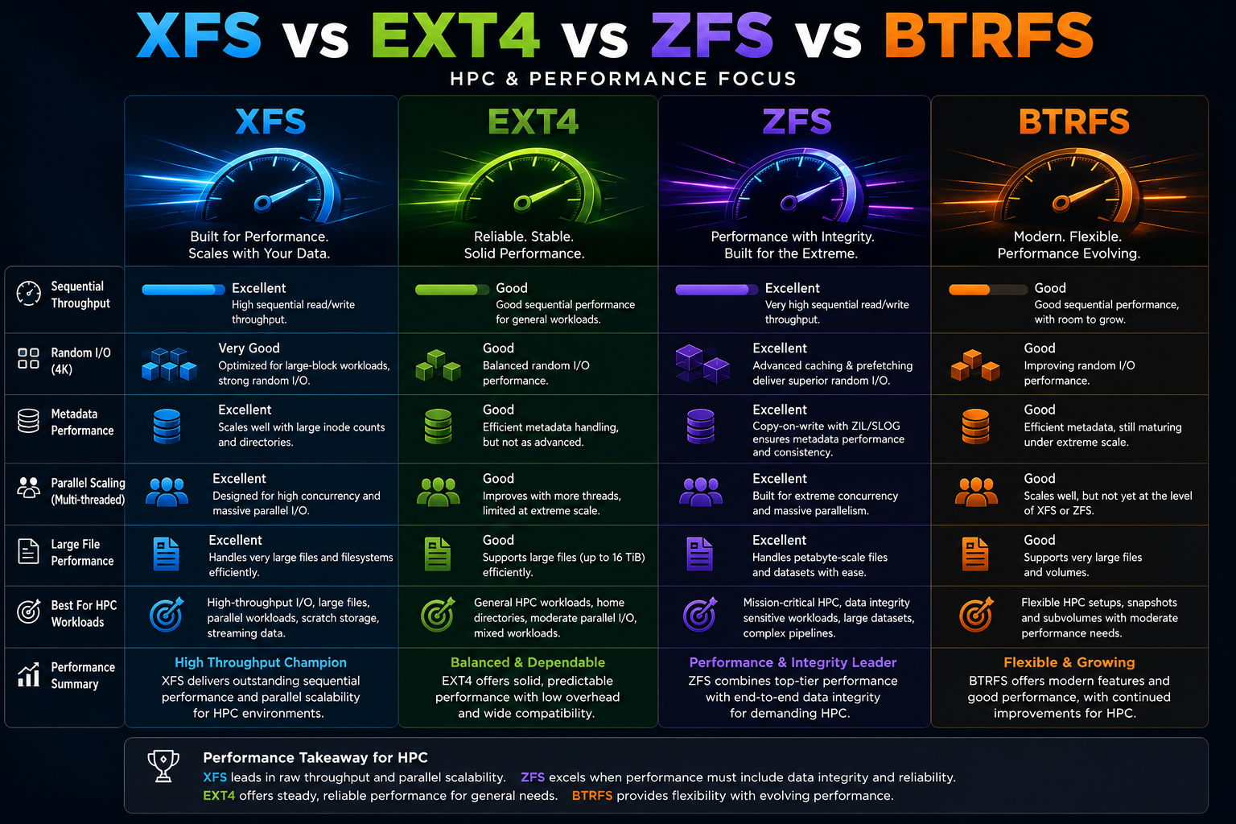

Linux File Systems
A.I. Summary

Slide 6
Linux File Systems
File system commands:
lsblk
sudo fdisk /dev/sdX
sudo mkfs -t ext4 /dev/sdX
sudo mount -t ext4 /dev/sdX /mnt/mydrive

Slide 7
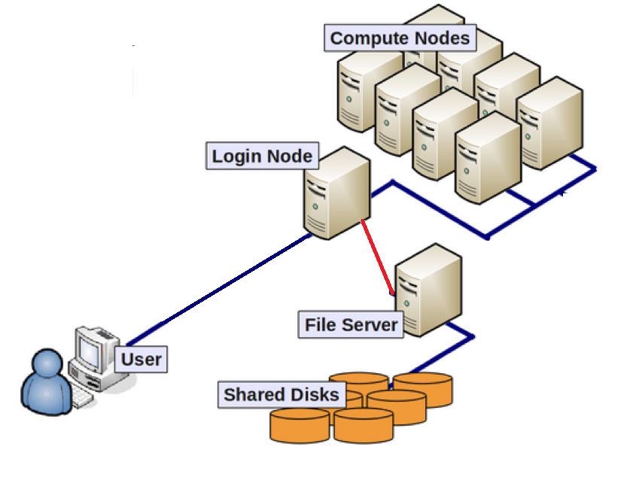
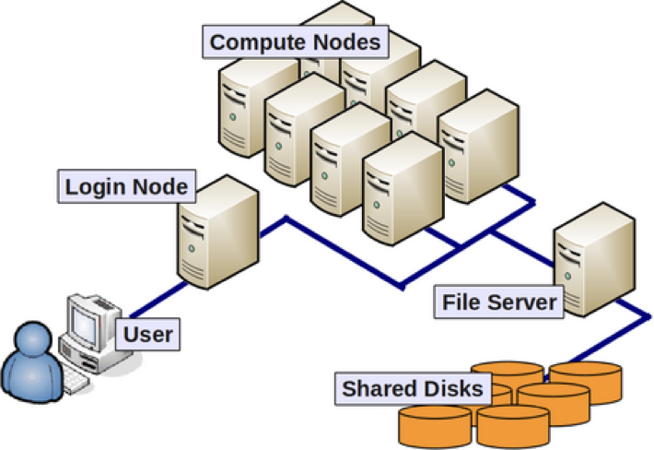
Linux Network File Systems
Notes:
Because we will be working with clusters, where we work with multiple compute nodes
We need files in central location
For beginners for this competition, we recommend using the login/head node as the storage server
We will show how to that

Slide 8
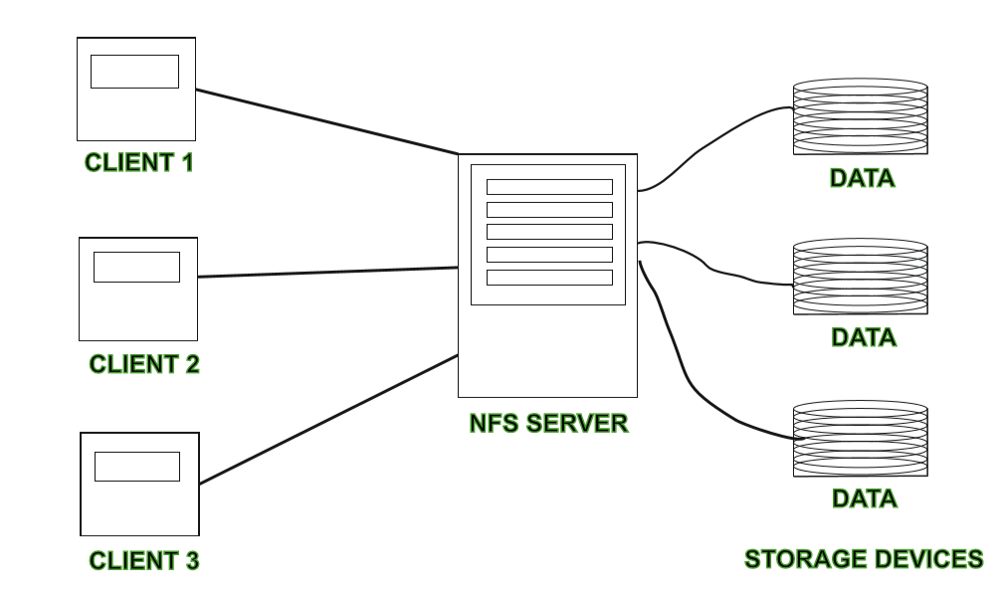
Linux Network File Systems
Notes:
This is essentially how a NFS works

Slide 9
Linux Network File Systems
Server
sudo dnf install nfs-utils -y
sudo nano /etc/exports
# ADD
/myShare 10.0.0.0/25(rw,async,no_subtree_check,no_root_squash)
sudo exportfs -ar
sudo systemctl enable --now nfs-server
Commands:
Verify
# Server
showmount –e
# Client
df -h
Client
sudo dnf install nfs-utils –y
sudo mount -t nfs <headnode ip/name>:/myShare /mnt/share
Notes:
Demo
rw (read-write)
Clients can read AND write
async (asynchronous writes)
The server replies to write requests before data is fully written to disk.
✅ Faster performance
⚠️ Risk: Possible data loss if server crashes before write completes
no_subtree_check
Disables subtree verification. Normally, NFS checks if a file belongs to the exported directory.
✅ Improves performance
no_root_squash
root user on the client to act as root on the server.
Note IP and subnet /25 0->127
Create share, chown permission
Create mount point, test

Slide 10

THANK YOU

