Slide 1

Monitoring your Cluster
CHPC SCC 2026 | Selection Round
Building the machine you compete on
Live session + live node teardown demo
Notes:
Hello everyone, and welcome to today’s session on monitoring an HPC cluster using Prometheus and Grafana.
During the Student Cluster Competition you’ll be deploying applications across multiple compute nodes, storage systems and networking components. As your cluster grows, it becomes increasingly difficult to understand what is happening simply by logging into each machine and running commands like top or free.
Monitoring gives us a single place where we can observe the health of the entire cluster in real time. Today I’ll introduce you to Prometheus and Grafana, explain how they fit into an OpenStack environment, and show you how they can help you diagnose problems before they become failures.
You don’t need to be an expert in Linux or monitoring to follow along. By the end of this presentation you’ll understand why monitoring is one of the most valuable tools you’ll have during the competition.

Slide 2

What We're Covering Today
1
2
Why Monitoring matters
What are Prometheus and Grafana
3
4
Monitoring an OpenStack cluster
The metrics that matter
5
Troubleshooting using dashboards
Notes:
Before we dive into the technology, here’s what we’ll cover.
We’ll begin by discussing why monitoring is important and how it saves valuable troubleshooting time.
Then we’ll introduce Prometheus and Grafana and see how they work together.
Next we’ll look at how monitoring fits into an OpenStack-based HPC cluster, followed by the most important metrics you should monitor.
Finally, we’ll walk through a real troubleshooting scenario using Grafana dashboards, showing how monitoring helps us quickly identify performance bottlenecks.

Slide 3
Why do we need Monitoring
Imagine this...
Your AI training job was running perfectly…
10 minutes later… Training is 3× slower.
What happened?
Is the CPU overloaded?
Has the system run out of memory?
Is the storage too slow?
Is the network saturated?
Has one compute node failed?
Without monitoring, you’re guessing.
With monitoring, you know.
Notes:
Before we start looking at Prometheus and Grafana, I’d like you to imagine a situation that could easily happen during the Student Cluster Competition.
You’ve spent the afternoon configuring your cluster. Everything is working well, and your application is running exactly as expected.
Then, without warning, the performance drops dramatically. A job that should finish in ten minutes is now taking thirty.
The first question most people ask is, “What’s wrong?”
But the better question is, “How do I find out what’s wrong?”
Is one of the compute nodes overloaded? Has the system run out of memory? Is the storage struggling to keep up with the workload? Or is the network becoming a bottleneck?
Without monitoring, you would need to log into each server individually, run commands such as top, free, df, or iostat, and try to piece together what is happening.
On a cluster with many nodes, that’s time-consuming and often frustrating.
Monitoring gives us a completely different approach. Instead of guessing, we can observe the entire cluster from a single dashboard and immediately identify where the problem is.
That’s exactly what Prometheus and Grafana help us do.
Transition
“So if monitoring helps us answer these questions, what exactly is monitoring, and how does it work? Let’s take a look.”

Slide 4
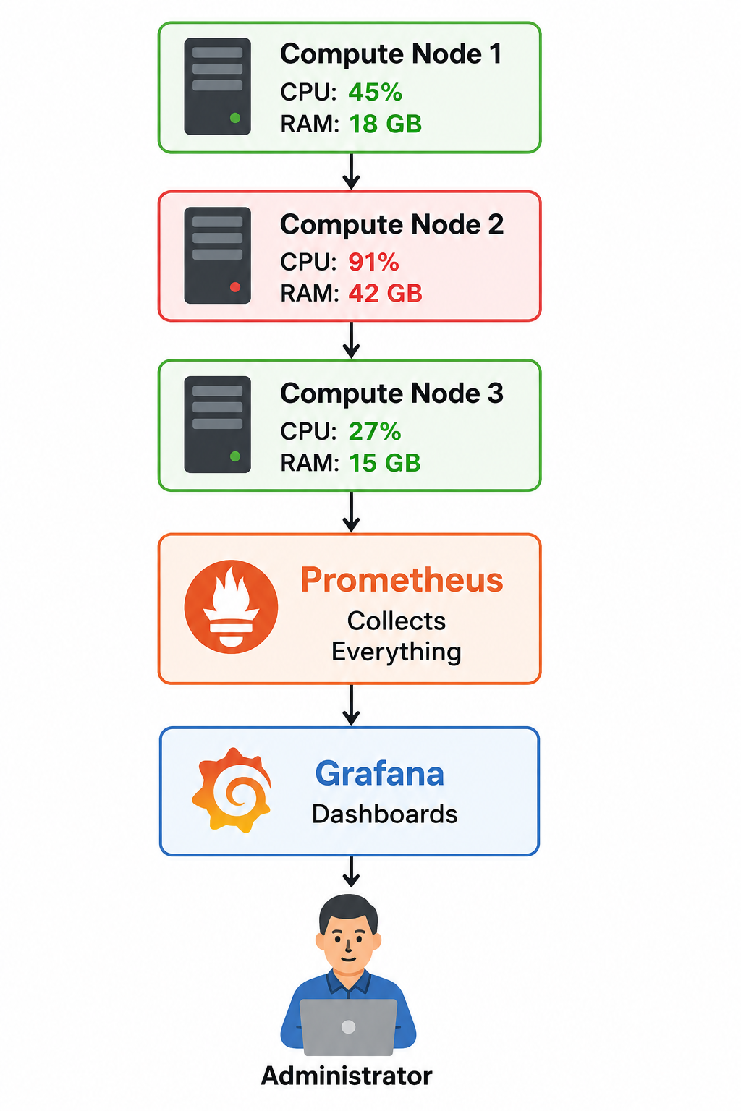
What is Monitoring?
Monitoring is simply collecting information about your systems over time
Every few seconds…
🖥️ Each server reports its health
📊 Prometheus stores the information
📈 Grafana turns it into dashboards
👨‍💻 You use the dashboards to understand your cluster
SCC CONTEXT
Notes:
Now that we understand why monitoring is important, let’s look at what monitoring actually is.
At its core, monitoring is simply the process of collecting information about your systems over time.
Imagine you have several servers in your cluster. Every few seconds, each server reports information about itself. Things like how busy the CPU is, how much memory is being used, how much disk space is available, and how much network traffic is flowing through the system.
All of this information is collected by Prometheus. Think of Prometheus as a notebook that continuously records the health of every server in your cluster.
Once the information has been collected, Grafana takes that data and transforms it into easy-to-read dashboards and graphs.
Instead of logging into every server individually, you can open a single dashboard and immediately see the health of your entire cluster.
One important thing to remember is that monitoring isn’t about collecting as much data as possible. It’s about collecting the right information so that you can understand what’s happening and make better decisions when something goes wrong.
Ask
“If one of your compute nodes suddenly started using 100% CPU, would you rather find out by logging into every server, or by looking at a dashboard that shows the entire cluster?”
Transition
“So we’ve seen the basic idea of monitoring. But what are the tools that make this possible? Let’s introduce the two technologies we’ll be using throughout this presentation: Prometheus and Grafana.”

Slide 5
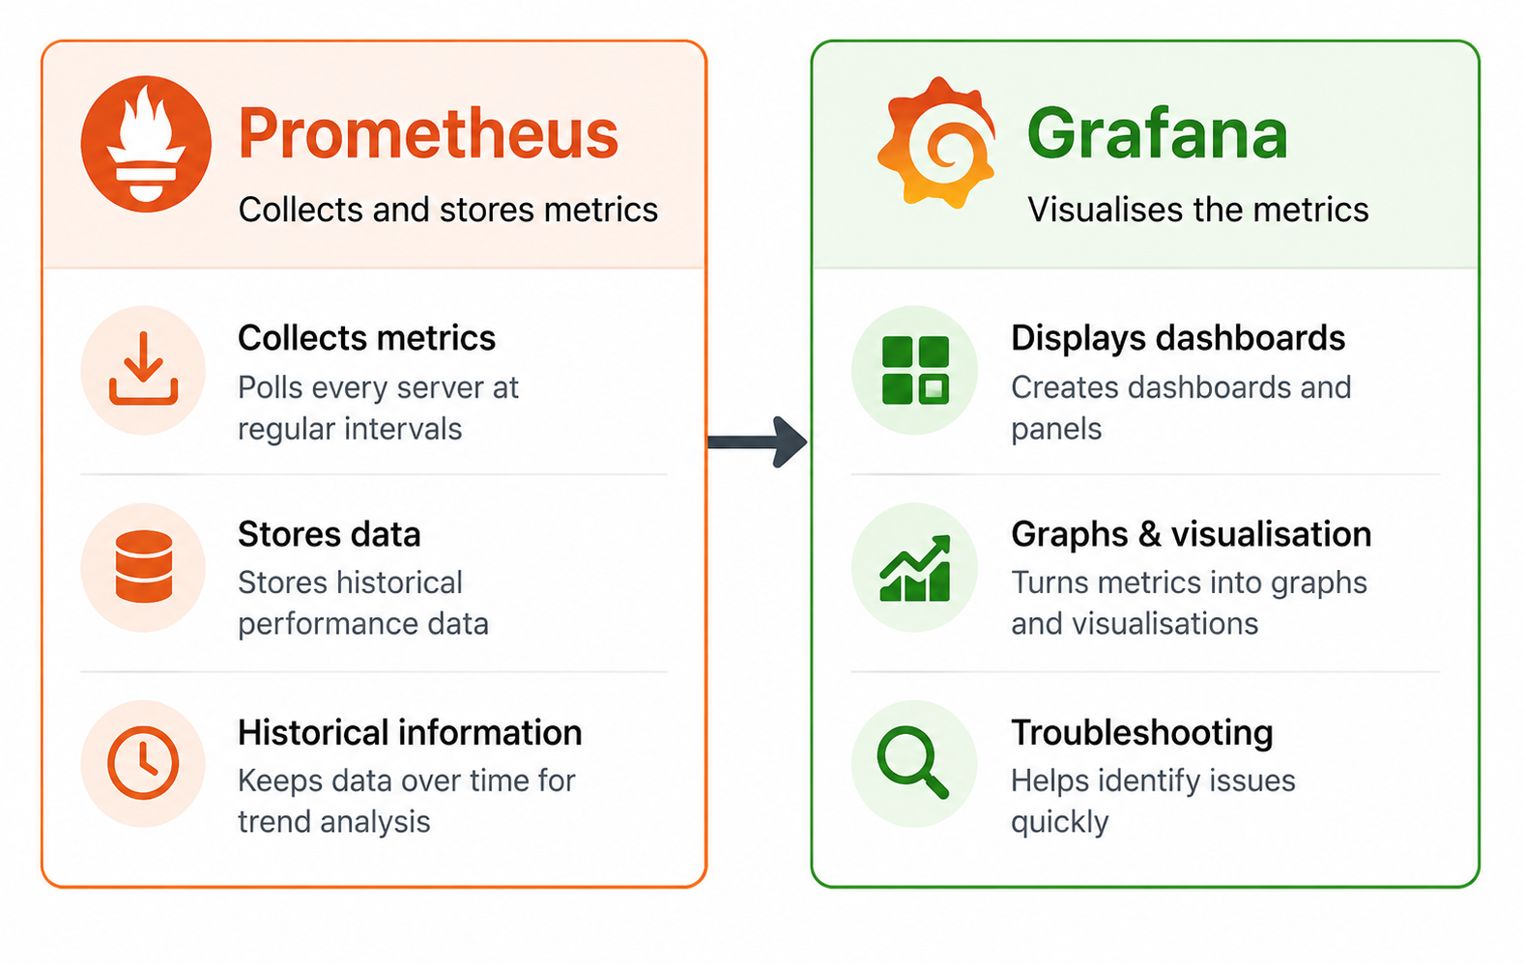
Prometheus and Grafana
Prometheus
Grafana
Collects and stores metrics
Polls every server at regular intervals
Stores historical performance data
Makes the data available for analysis
Visualises the metrics
Creates dashboards and graphs
Makes trends easy to understand
Helps identify problems quickly
SCC CONTEXT
Notes:
We’ve already seen that monitoring involves collecting information from our servers and displaying it in a meaningful way. To achieve this, we use two separate tools that work together.
The first tool is Prometheus. Prometheus is responsible for collecting metrics from all the systems we want to monitor. Every few seconds, it connects to each server and records information such as CPU usage, memory consumption, disk activity, and network traffic. It stores this information over time, allowing us to look back and see how the system has behaved.
The second tool is Grafana. Grafana doesn’t collect any information itself. Instead, it connects to Prometheus and turns all of those numbers into dashboards, charts, and graphs that are much easier for humans to understand.
Think of it like this: Prometheus is the notebook that records everything that’s happening, while Grafana is the window that lets us view and interpret that information.
Together, they provide a complete monitoring solution that allows us to understand the health and performance of our cluster at a glance.
Transition
“Now that we know what Prometheus and Grafana do, the next question is: where do they fit into an HPC cluster? Let’s look at how monitoring integrates into an OpenStack environment.”
Pause after asking:
“Which tool do you think actually collects the data?”
Then answer it:
“It’s Prometheus. Grafana only displays the information.”

Slide 6
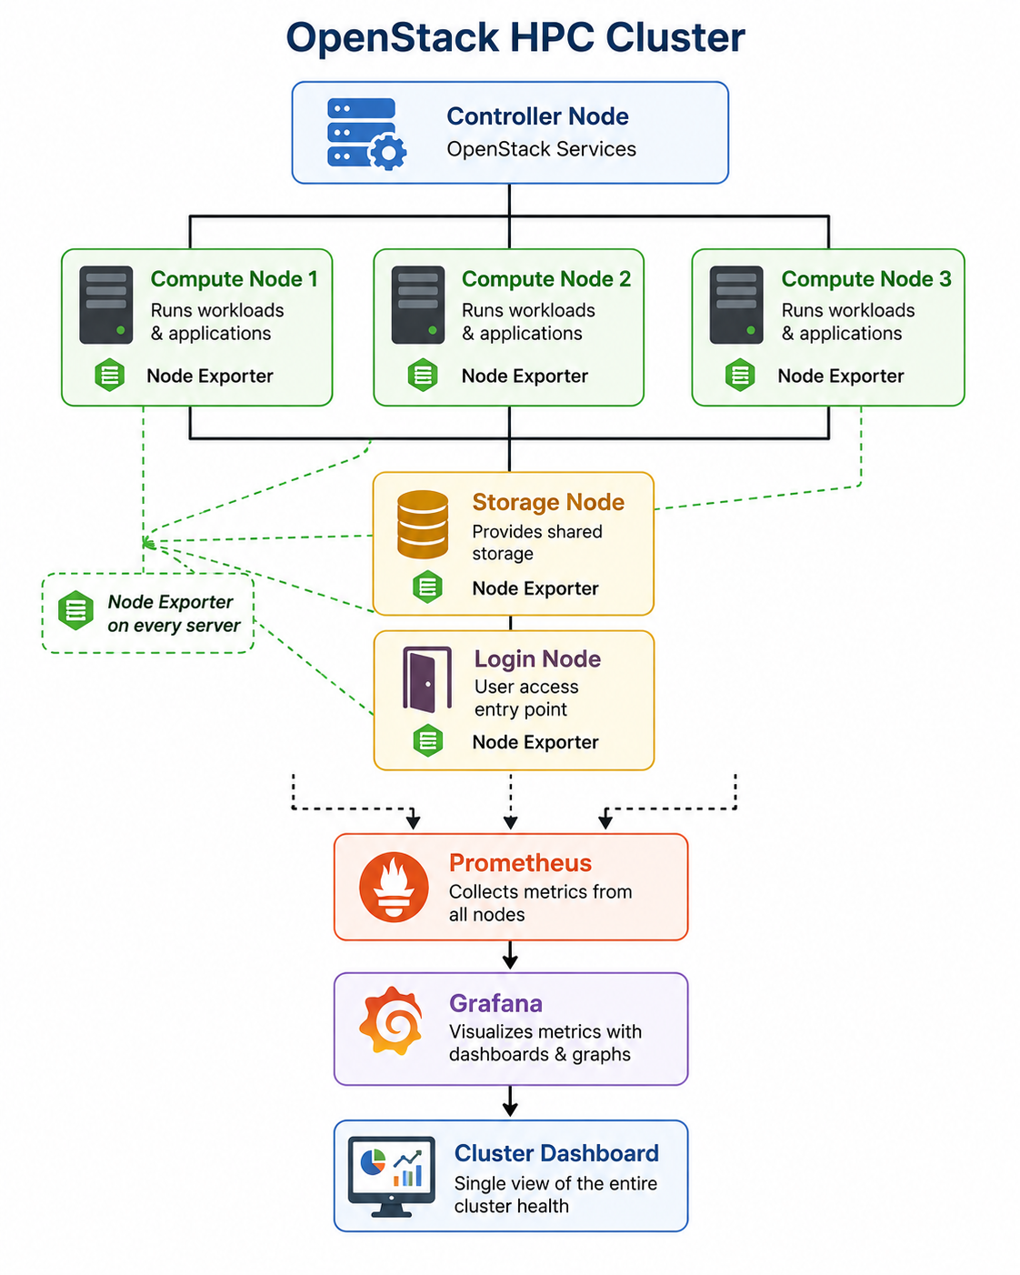
Monitoring an OpenStack Cluster
Where does Prometheus fit into the Cluster?
SCC CONTEXT
Notes:
So far, we’ve looked at monitoring in general. Now let’s see how it fits into the type of cluster you’ll be working with during the Student Cluster Competition.
An HPC cluster running on OpenStack is made up of several different types of machines, each with a specific purpose.
The controller node manages the OpenStack services and coordinates the cluster.
The compute nodes are where your applications and workloads actually run. Depending on the competition, you may have several compute nodes working together to solve a single problem.
You’ll also have storage nodes, which provide shared storage for applications and data, and a login node, which acts as the entry point for users connecting to the cluster.
Each of these machines can tell us something about its health. We install a lightweight monitoring agent called Node Exporter on every server. Node Exporter collects information such as CPU usage, memory usage, disk activity, and network traffic.
Prometheus then contacts each of these nodes every few seconds and gathers those metrics. Finally, Grafana displays everything on a single dashboard.
Instead of checking each machine individually, you can see the health of your entire cluster from one place.
One thing I’d like you to remember is this: Prometheus and Grafana are not part of OpenStack itself. They don’t manage virtual machines or schedule workloads. They simply observe what’s happening and help you understand the behaviour of your cluster.

Slide 7
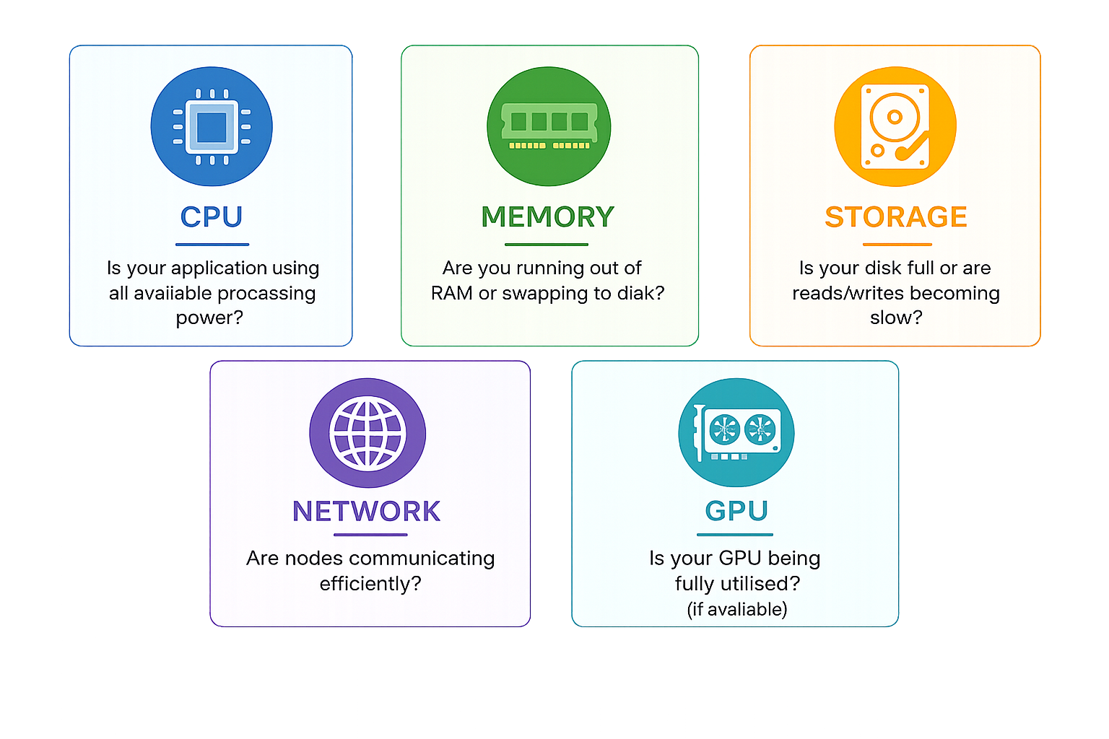
What metrics matter?
Where does Prometheus fit into the Cluster?
The goal isn't to monitor everything. The goal is to monitor the metrics that help you to identify performance bottlenecks.
SCC CONTEXT
Notes:
We’ve now seen how Prometheus collects information and how Grafana displays it.
But what information should we actually pay attention to?
The first and probably most familiar metric is CPU utilisation. This tells us how much of the processor is being used. During a heavy computation, it’s perfectly normal to see CPU usage close to one hundred percent. In fact, that’s often what we want in an HPC environment.
Next is memory usage. If an application starts using more memory than the system has available, Linux begins moving data to disk in a process called swapping. Since disks are much slower than RAM, this can have a significant impact on performance.
We also monitor storage. If a filesystem becomes full or disk activity becomes a bottleneck, applications may slow down or even fail completely.
Another important area is network traffic. Many HPC applications use multiple compute nodes that constantly exchange information. If the network becomes congested, the entire application can slow down even though the CPUs themselves are not fully utilised.
Finally, if your cluster contains GPUs, monitoring GPU utilisation, memory usage, temperature, and power consumption becomes extremely important. A GPU sitting idle during a machine learning workload is often a sign that something isn’t configured correctly.
The important thing to remember is that monitoring isn’t about collecting hundreds of graphs. It’s about identifying the few metrics that tell you whether your cluster is healthy and where performance problems are occurring.
Ask the students:
“If your application suddenly becomes slower, which metric would you check first?”
Pause for a second.
Then say:
“The answer is… it depends. That’s why monitoring multiple metrics together is so valuable.”
Transition
“Now that we know which metrics are important, let’s look at what those metrics actually look like in Grafana and learn how to interpret a real dashboard.”

Slide 8
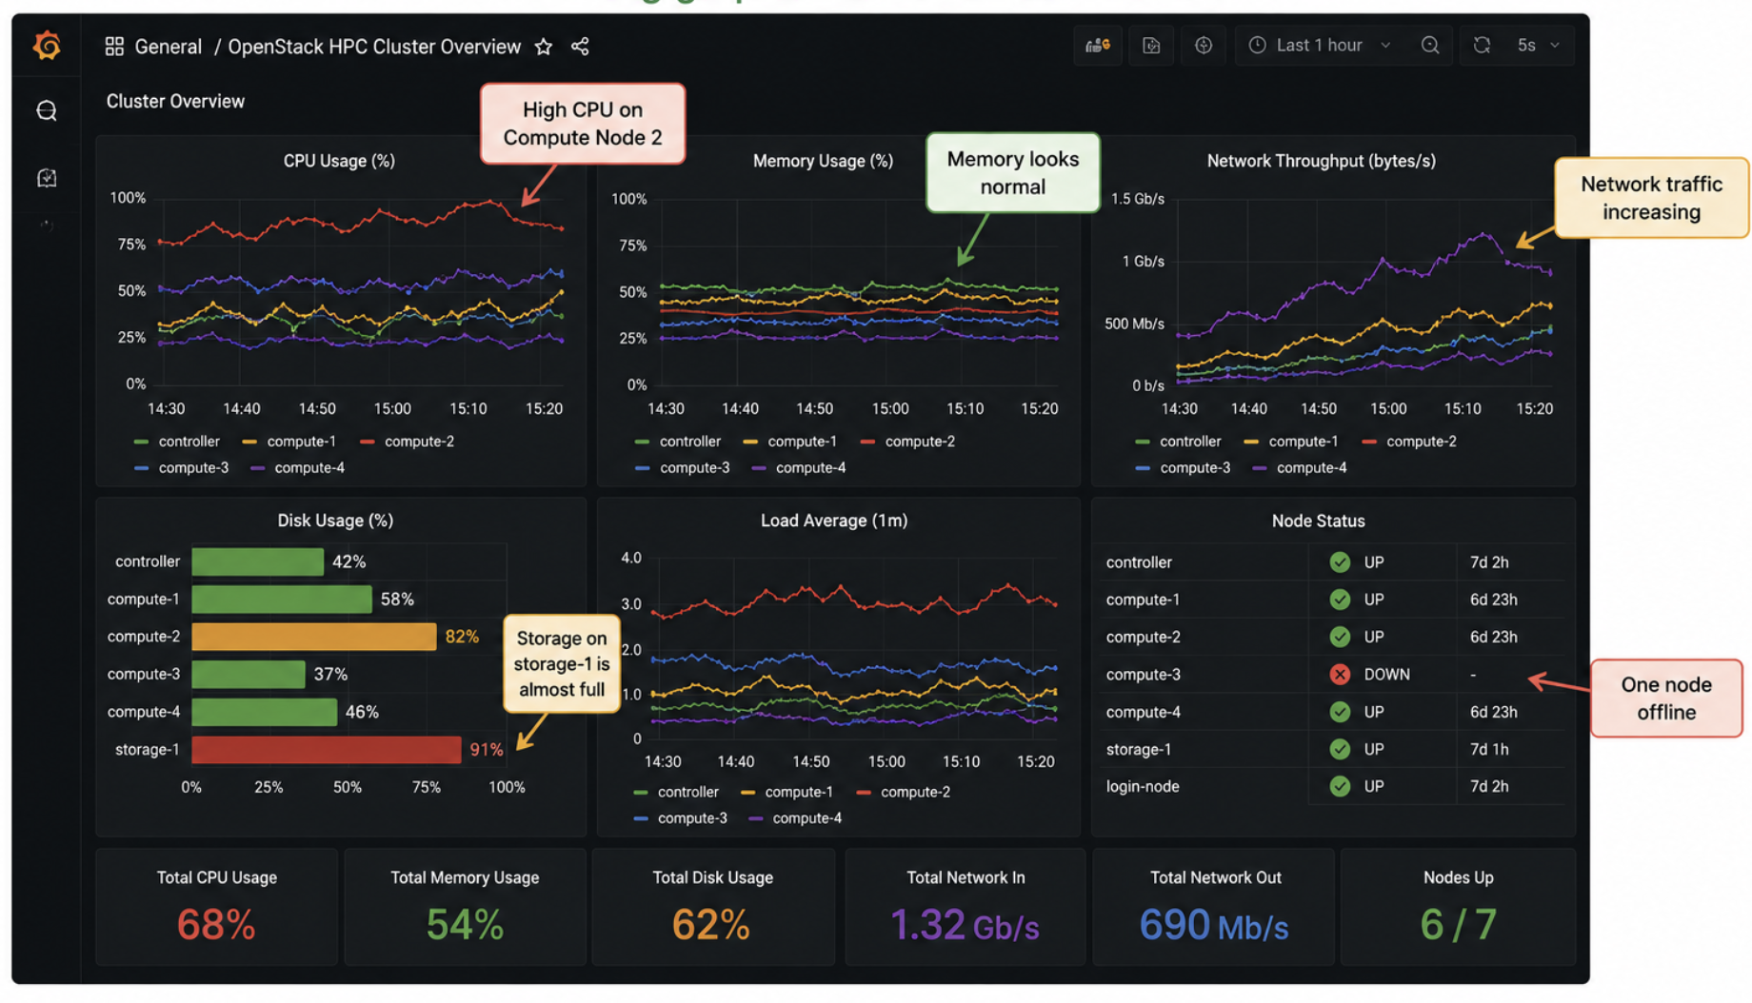
Reading a Grafana Dashboard
Turn graphs into useful information
Turning graphs into useful information
SCC CONTEXT
Notes:
Now that we know which metrics are important, let’s look at how they’re presented in Grafana.
At first glance, a Grafana dashboard can seem overwhelming. There are lots of graphs, gauges, numbers and colours.
But the goal isn’t to study every graph individually. Instead, we want to understand the overall health of the cluster.
The first question I ask is: Does anything stand out?
Are all the compute nodes showing similar CPU utilisation, or is one node working much harder than the others?
Is memory usage stable, or is it increasing over time?
Are the network graphs showing normal traffic, or is there an unexpected spike?
Is disk usage growing steadily, or is a filesystem about to become full?
By asking these questions, you begin to build a picture of what’s happening across the cluster.
One important point to remember is that graphs should never be viewed in isolation.
For example, high CPU usage isn’t necessarily a problem. During an HPC workload, we often expect CPUs to be close to one hundred percent utilisation.
However, if CPU usage is low while your application is running slowly, that might indicate the processors are waiting for data from storage or the network.
Good monitoring isn’t about finding high numbers. It’s about understanding why those numbers look the way they do.
Transition
“Now that we know how to read a dashboard, let’s put that knowledge into practice. Imagine one of your jobs suddenly becomes much slower than expected. How would we use Grafana to find the cause?”

Slide 9
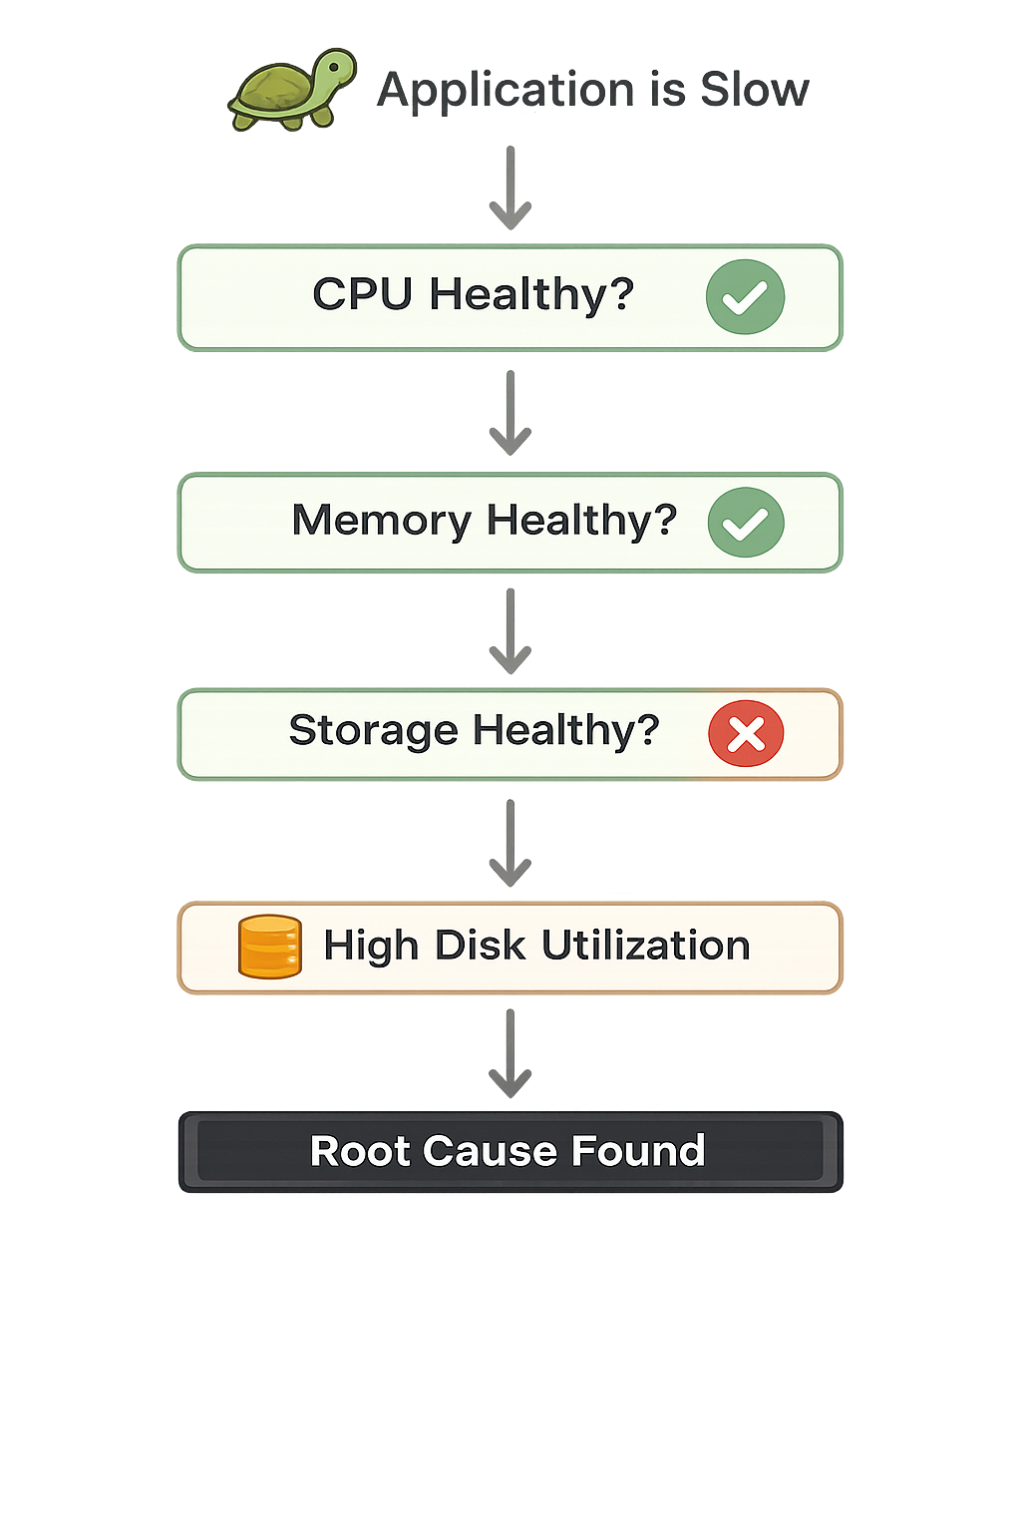
Trouble-shooting a slow application
Using Monitoring to find the root cause
SCC CONTEXT
Notes:
Let’s put everything we’ve learned into practice.
Imagine you’re participating in the Student Cluster Competition and your application suddenly becomes much slower than expected.
Yesterday, your benchmark completed in ten minutes.
Today, it’s taking thirty.
The first instinct for many people is to start changing configuration files or restarting services. But experienced engineers take a different approach.
They investigate before making changes.
The first thing I’d check is CPU utilisation. If the processors are running close to one hundred percent, then perhaps the workload has simply become more demanding.
But suppose CPU usage looks perfectly normal.
Next I’d check memory usage. Is the system running out of RAM? Has Linux started swapping memory to disk?
If memory also looks healthy, I’d move on to storage.
Here I might notice that disk utilisation is extremely high, or that read and write operations are taking much longer than normal.
That tells me the CPUs aren’t waiting for more work—they’re waiting for data from storage.
If storage also looks healthy, I’d investigate the network, especially if my application is distributed across multiple compute nodes.
The important lesson is that monitoring allows us to eliminate possibilities one by one until we identify the real bottleneck.
Instead of guessing, we’re making decisions based on evidence.
Transition
“Finding the problem is only part of the story. What if we could be notified before users even notice something is wrong? That’s where alerts come in.”

Slide 10
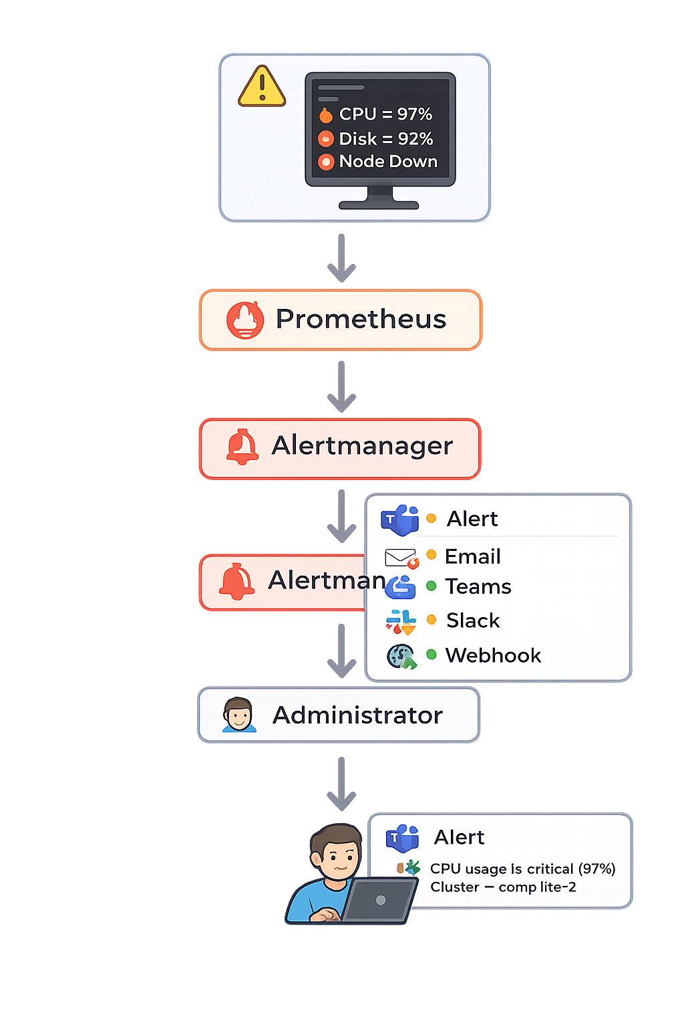
Alerts and Notifications
Know about problems before users do
Dashboards help you see problems.
Alerts help you respond to problems immediately.
Examples of alerts:
🔥 CPU usage above 90%
💾 Disk usage above 85%
🧠 Memory running low
🌐 Compute node offline
⚠️ High network latency
SCC CONTEXT
Notes:
So far, we’ve focused on using dashboards to understand the health of our cluster. Dashboards are excellent when you’re actively monitoring your systems, but what happens if you’re not looking at the dashboard when something goes wrong?
That’s where alerts become incredibly useful.
Instead of expecting you to constantly watch Grafana, Prometheus can automatically detect when something unusual happens.
For example, you might configure an alert to trigger if CPU utilisation stays above ninety percent for more than five minutes, or if a filesystem reaches eighty-five percent capacity. You could also receive an alert if a compute node goes offline or if memory usage becomes critically high.
When one of these conditions is met, Prometheus sends the alert to a component called Alertmanager.
Alertmanager is responsible for delivering the notification. Depending on your environment, it can send an email, a Microsoft Teams message, a Slack notification, or even trigger an automated workflow through a webhook.
In our OpenStack environment, we use Microsoft Teams to receive alerts. This means that instead of discovering problems after users report them, we can often begin investigating as soon as the issue occurs.
The key takeaway is that dashboards help us understand what’s happening, while alerts help us respond quickly. Together, they form a complete monitoring solution.
Ask:
“Would you rather discover that a disk is full after a job has failed, or receive a notification while there’s still time to fix it?”
Transition
“We’ve covered monitoring, dashboards, and alerts. Before we finish, I’d like to share a few practical tips and best practices that will help you get the most out of your monitoring system during the competition.”

Slide 11
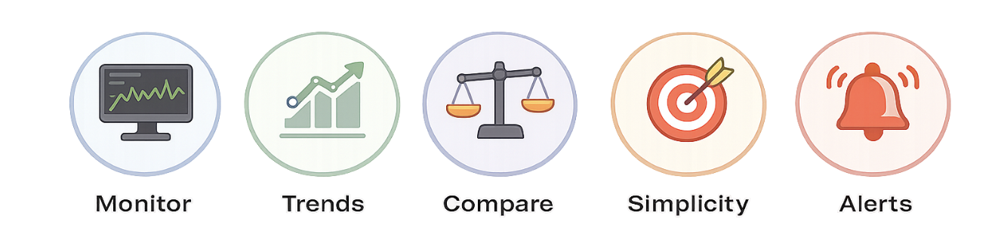
Monitoring Best Practises
Simple habits that make troubleshooting easier.
SCC CONTEXT
TIP
Monitoring isn't about collecting data.​ It's about making better decisions.​
Notes:
So far, we’ve focused on using dashboards to understand the health of our cluster. Dashboards are excellent when you’re actively monitoring your systems, but what happens if you’re not looking at the dashboard when something goes wrong?
That’s where alerts become incredibly useful.
Instead of expecting you to constantly watch Grafana, Prometheus can automatically detect when something unusual happens.
For example, you might configure an alert to trigger if CPU utilisation stays above ninety percent for more than five minutes, or if a filesystem reaches eighty-five percent capacity. You could also receive an alert if a compute node goes offline or if memory usage becomes critically high.
When one of these conditions is met, Prometheus sends the alert to a component called Alertmanager.
Alertmanager is responsible for delivering the notification. Depending on your environment, it can send an email, a Microsoft Teams message, a Slack notification, or even trigger an automated workflow through a webhook.
In our OpenStack environment, we use Microsoft Teams to receive alerts. This means that instead of discovering problems after users report them, we can often begin investigating as soon as the issue occurs.
The key takeaway is that dashboards help us understand what’s happening, while alerts help us respond quickly. Together, they form a complete monitoring solution.
Ask:
“Would you rather discover that a disk is full after a job has failed, or receive a notification while there’s still time to fix it?”
Transition
“We’ve covered monitoring, dashboards, and alerts. Before we finish, I’d like to share a few practical tips and best practices that will help you get the most out of your monitoring system during the competition.”

Slide 12
Key Takeaways
1
HPC Cluster
2
Collect Metrics
3
Visualize
4
Understand the numbers
5
Solve problems
6
Great engineers don’t rely on assumptions, they rely on DATA.
Notes:
Before we finish, I’d like to leave you with five key ideas that I hope you’ll remember during the Student Cluster Competition.
First, monitoring gives you visibility into your cluster. If you can’t see what’s happening, you’ll spend most of your time guessing.
Second, remember that Prometheus is responsible for collecting the metrics from every server. It continuously records the health and performance of your systems.
Third, Grafana transforms those metrics into dashboards that make complex systems much easier to understand.
Fourth, no single metric tells the whole story. CPU, memory, storage, and network activity all work together to help you identify bottlenecks and understand system behaviour.
Finally, perhaps the most important lesson is this: don’t guess. Always use the information available to you before making changes to a system. A structured, data-driven approach to troubleshooting will save you time, reduce frustration, and help you solve problems more effectively.
Whether you’re working on an HPC cluster during this competition or managing production systems in the future, these principles remain the same.
I hope today’s session has shown you that monitoring isn’t just about graphs and dashboards—it’s about understanding your systems so you can make better decisions.
Transition
“Thank you for your time. I hope this presentation has given you a solid foundation for monitoring your HPC cluster. I wish you the very best for the Student Cluster Competition, and I’m looking forward to seeing what you build.”

Slide 13

HPC Hardware - CHPC SCC 2026

