Slide 1

Putting together an HPC Cluster
CHPC SCC 2026 | Selection Round
by Anna Lukose

Slide 2

Cluster Design Process
Understand Workload
What is it bound by?
Fix hard constraints
Budget, power etc
Pick components
Maximise resources the workload is bound by
Predict on paper
Rpeak, watts etc
Build and Benchmark
Tune Software

Slide 3


Common Bottlenecks
Bottleneck | Hardware Answer
Compute-bound | Max cores, clock, vector width -> Rpeak!
Memory bandwidth-bound | More memory channels - balance, fewer cores/socket
Memory capacity-bound | Bigger DIMMs
Network-bound | Low-latency, high-bandwidth fabric
I/O-bound | Fast storage path, NVMe/parallel FS; packed formats for small files

Slide 4
Your problem
1
Budget: R650 000
2
Your applications to consider:
- WRF: A weather simulator that tests how well a computer handles massive amounts of climate data and how efficiently its processors talk to each other to predict the weather.
SOD2D: A simulation tool that mimics how air or liquid flows
ASCOT5: A simulator that tracks millions of tiny particles moving inside a nuclear fusion reactor
FIO: A tool that mimics everyday file-saving and loading tasks to measure exactly how fast a computer can read and write data to its hard drive

Slide 5
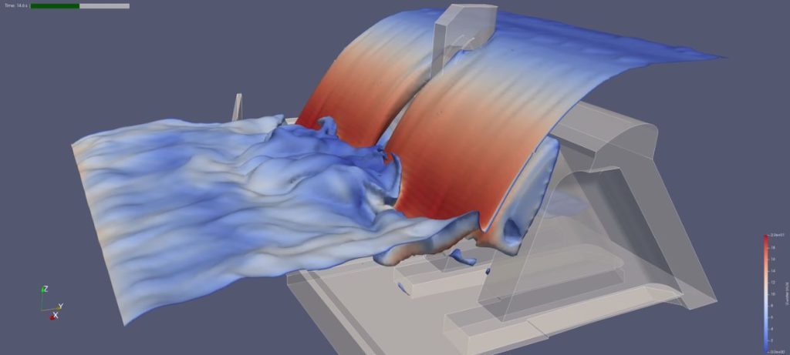
My problem
OpenFOAM
Open-source C++ CFD Toolbox
Budget:
R3 million
Known Bottlenecks:
Memory Bandwidth
Parallel I/O
After understanding the bounds, let’s move onto the price list!

Slide 6


