Slide 1


Environment Management Tools
CHPC SCC Selection 2026
presented by Thina Calana

Slide 2



What is Environment Management?
CHALLENGES
SOLUTIONS
Multiple user environment sharing hardware
Frictionless accessibility
Complex dependency chains & version control requirements
Scientific reproducibility
High user and admin productivity
Tools for controlled reproducible software environment

Slide 3






Some HPC Solutions
Module systems
dynamically control the shell environment
Package managers
build and install software from source or binaries
Containers
bundle the entire software stack into a portable
reproducible image

Slide 4
Module System: Lmod
Lmod is a lua-based module system that dynamically modifies the shell environment through variables like PATH and LD_LIBRARY_PATH.
Standard on most clusters worldwide
Key features
  Version control
  Support both .lua and TCL modulefiles
  Hierarchical module system

Slide 5
Package Manager: Spack & Conda
Spack is an open-source package manager that builds software from source with full control over compilers, versions and dependencies.
  automatically generate modulefiles
  spack install openmpi@4.1.5 %gcc@12.3
Conda is a cross-platform package and environment manager.
  Dominant in python, R and data science
  Isolated projects environments.
  conda create –n myewnv python=3.11
  conda activate myenv

Slide 6
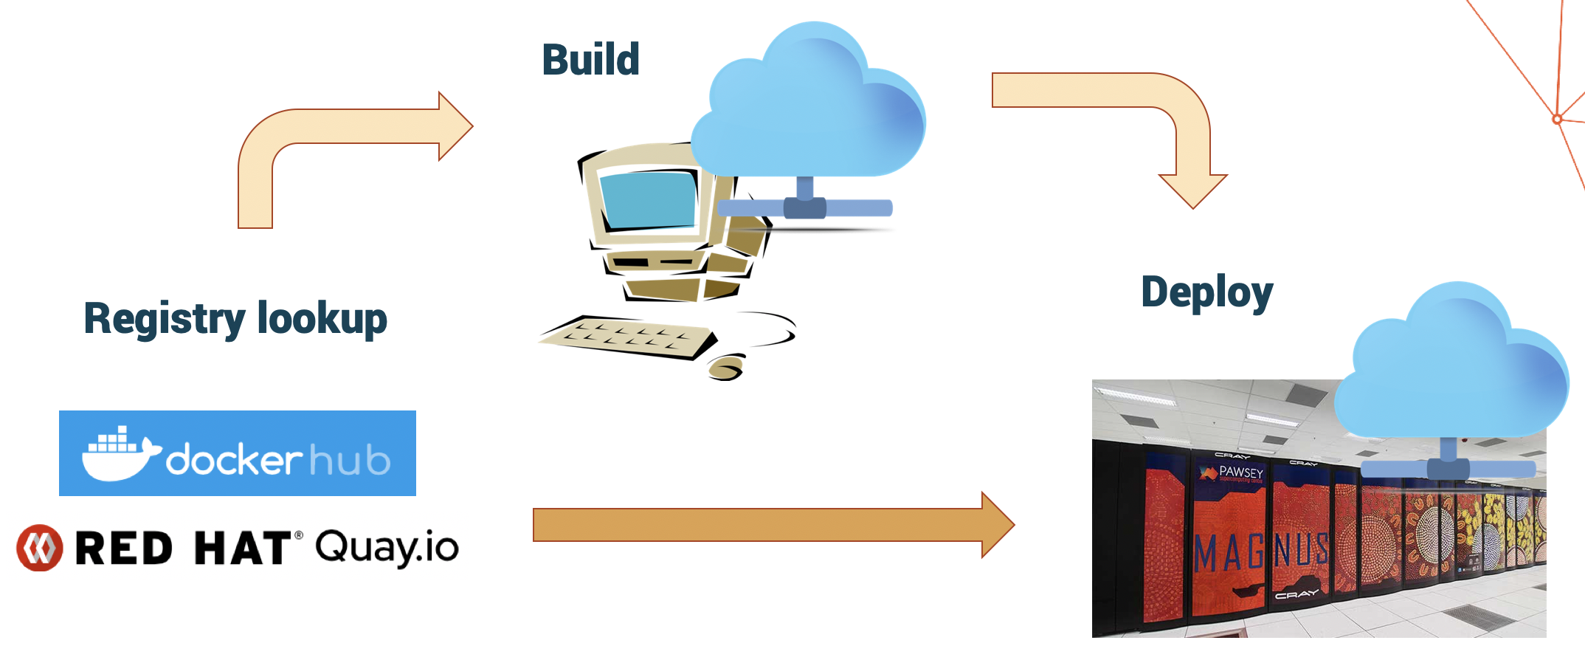
Containers: Docker
HPC Containers
Bundle entire software stack into a portable ‘box’.
Guarantee identical code across different machines.
A dominant container platform, Docker, requires root & daemon privileges.
docker build –t myimage

Slide 7
Containers: Apptainer & Enroot
HPC-native runtime containers like
Apptainer an open-source continuation of Singularity
  Can natively run Docker container without complex daemon.
Enroot converts standard container image in unprivileged boxes
  Optimized for fast, large-scale computing
Container Advantages
  Reproducibility,
  Portability,
  Reduce application complexity.

Slide 8
Tool Comparison
Environment Tools | Types | Root Required | HPC Native | Best Use Case
Lmod | Module System | No | Yes | Managing system-installed software
Spack | Package Manager | No | Yes | Optimised source build for HPC
Conda | Package Manager | No | Partial | Python/R/bioinformatics workflows
Docker | Container | Yes (daemon) | No | Building portable images
Apptainer | Container | No | Yes | Running containers on HPC clusters

Slide 9
LMOD DEMONSTRATION

Slide 10
TCL modulefiles
Original modulefile format and still fully supported by Lmod
  Backwards compatible
Every TCL modulefile starts with
.
#%Module1.0
You can visit Lmod website for TCL directives
https://lmod.readthedocs.io/en/latest/051_tcl_modulefiles.html

Slide 11
Lua modulefiles (.lua)
Native modulefile format for Lmod
  Cleaner syntax
  Better error messages
  Enable hierarchy and family() declaration
Lua modulefiles use .lua extension
You can visit Lmod website for TCL directives
https://lmod.readthedocs.io/en/latest/050_lua_modulefiles.html

Slide 12
Modulefile generation when scripting

Slide 13

THANK YOU

