Slide 1


Compiler Tools
Thina Calana

Slide 2

What are Compiler Tools?
Compiler tools translate source code written in high-level languages into machine-executable programs that a CPU or GPU can run.
Why Compilers Matter in HPC
  Improve performance (hardware-specific optimisation)
  Enable parallel computing
  Generate architecture-specific machine code for maximum efficiency

Slide 3

GNU Compiler Collection (GCC)
Open-source compiler suite and the standard compiler on most Linux HPC clusters
Supports a wide range of programming languages

Slide 4
GCC Advantages
Free and widely available — installed by default on most clusters
Strong standards compliance and extensive community documentation
Compatible with nearly all open-source scientific software
Excellent starting point before moving to vendor-optimised compilers

Slide 5
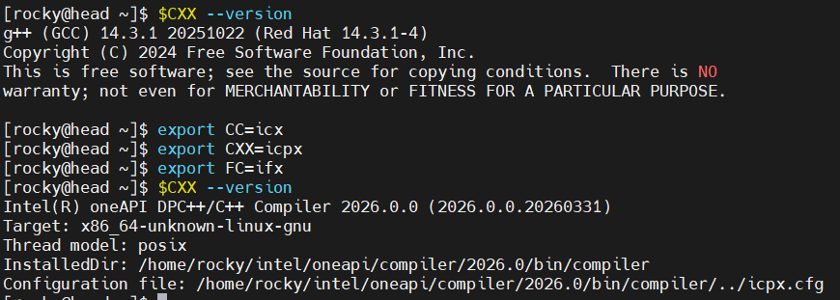
Intel OneAPI Toolkit
A unified suite providing compilers, libraries, and performance analysis tools for Intel hardware

Slide 6
OneAPI Advantages
Highly optimised for Intel Xeon processors (Sapphire Rapids, etc.)
Advanced auto-vectorisation and instruction-level parallelism
Full OpenMP support for multi-threaded workloads
Bundled with MKL (Math Kernel Library) and MPI libraries

Slide 7
AOCC & NVIDIA HPC SDK
AOCC is AMD’s compiler suite based on the LLVM/Clang.
Nvida’s hpc sdk provides tools for CPU & GPU acceleration
 | COMPILER | AMD | NVIDIA
$CC | C compiler | gcc | nvc
$CXX | C++ compiler | g++ | nvc++
$FC | Fortan compiler | gfortran | nvfortran

Slide 8
Configuration and Build
Options supplied to build systems and compilers to control how software is compiled and installed are configuration flags.
The same source code can produce dramatically different performance depending on the flags used.
Config flags allow control of:
  Optimiztion,
  Parallelism support,
  Installation location,
  Debug options

Slide 9
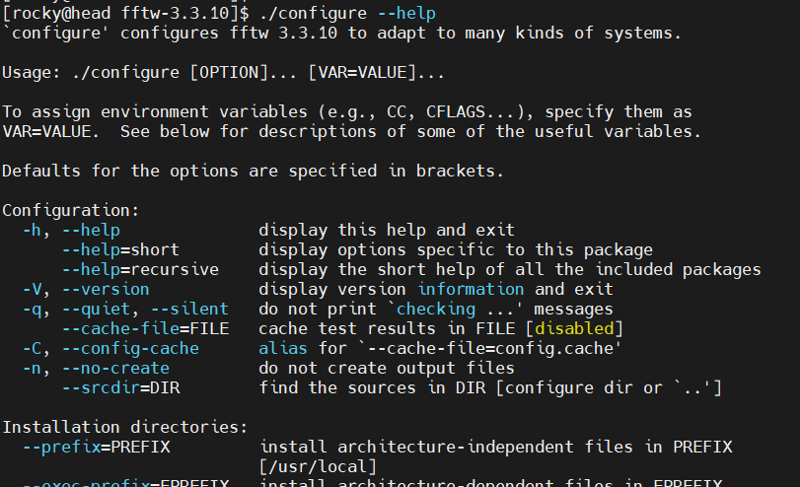
Example viewing config options

Slide 10
Common config flags
Use --help or –h to list config options
FLAG | DESCRIPTION
--prefix=/path | Install architecture-independent files in PREFIX
--enable-FEATURE | Include listed FEATURE [ARG=yes]
--enable-openmp | Activate OpenMP multithreading support
--enable-shared | Enable building a shared library
--with-PACKAGE[=ARG] | Use PACKAGE [ARG=yes]
--with-mpi=/path | Link with mpi library for distributed parallelism support
--with-openssl=DIR | Root of the OpenSSL directory

Slide 11
Common environment variables
Below are compiler flags exa,ples for CFLAGS/CXXFLAGS
FLAG | DESCRIPTION
-O1/-02/-03 -Ofast | Optimisation levels (-O3 most aggressive)
-fopenmp | Enable OpenMP multi-threading support
-march=ARCH | Optimise for specified or native processor architecture
-mtune=ARCH | Finetune instruction scheduling for processor architecture
-g | Embed debug symbols

Slide 12
Configuration Example
CC=icx CFLAGS"-O3 –fopenmp –march=icelake" ./configure –enable-shared –prefix=$HOME/opt/

Slide 13




Parallel Programming support
OpenMP
MPI
OpenACC
CUDA
Shared-memory parallelization via compiler directives.
Distributed-memory communication for multi-node scaling.
Directive-based offloading for GPUs (alternative to CUDA).
Direct GPU programming for maximum performance control.

Slide 14

THANK YOU

