Slide 1


Benchmarking and HPL
CHPC SCC 2026 | LIVE PRESENTATION & DEMO

Slide 2

What is “benchmarking”?
Measuring performance against a standard or competitor
Each team is a competitor
Each benchmark is unique and situational

Slide 3
Benchmarking parameters
Kitchen |  | HPC
Waiting time (How long does the customer wait?) |  | FLOPS (Floating point operations per second)
Cost (How much does the food cost?) |  | Memory bandwidth (Memory data moved per second)
Daily production (How many can be prepared in a day?) |  | Storage read/write speed (How fast data moves to/from storage)
Taste (How good is the final meal?) |  | Accuracy (How precise the final calculation is)

Slide 4
Floats, FLOPS and Matrices
Variable |  | Value
Temperature |  | 37.5°C
Velocity |  | 98.1 m/s
Pressure |  | 101.325 kPa
Pi |  | 3.14159
FLOPS (Floating Point Operations Per Second)
1 floating point operation:
A + B
2 floating point operations:
A * B + C
Computers use many floating point operations when solving matrix equations.

Slide 5
The Synthetic Benchmark: HPL
Rank | System | Cores | Rmax (PFLOPS)
1 | LineShine (China) | 13,789,440 | 2,198.4
2 | El Capitan (US) | 11,340,000 | 1,809.0
3 | Frontier (US) | 9,066,176 | 1,353.0
4 | Aurora (US) | 9,264,128 | 1,012.0
5 | JUPITER Booster (Germany) | 4,801,344 | 1,000.0

Slide 6
RPeak vs. RMax
RPeak is the theoretical maximum possible for the system.
RPeak = # of Nodes * # of Sockets per Node * # of Cores per Socket * CPU Frequency * Operations per cycle
E.g. A compute node with 16 cores @ 4 MHz, using AVX512
Rpeak = (1) * (1) * (16) * (4 * 10^6) * (32)
= 1.229 GFLOPS
If the system has 4 identical compute nodes:
1.229 * 4 = 4.915 GFLOPS total
CPU Extension | Floating point operations per CPU cycle
SSE4.2 | 4
AVX | 8
AVX2 | 16
AVX512 | 32

Slide 7
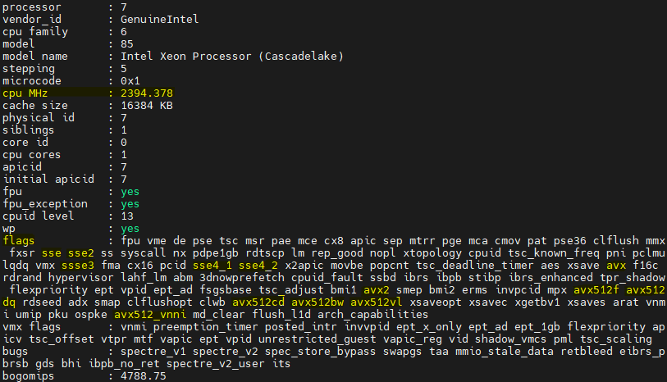
CPU core information
$ cat /proc/cpuinfo

Slide 8
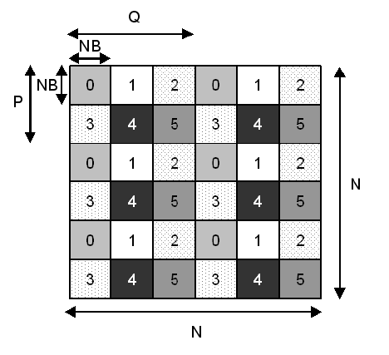
HPL configuration
N: total problem size
NB: block size
P * Q: total ranks
Threshold: residual comparison test value

Slide 9

Problem size (N)
Run: echo | gcc -E -dM - | grep -E "SIZEOF_DOUBLE"
$$N=α\sqrt{\frac{\# of nodes ∗RAM size \left(GiB\right)∗ {1024}^{3}}{sizeof(double)}}$$
Set $α$ to a percentage so that memory usage doesn’t spill over into swap memory.
N should be a multiple of NB.

Slide 10

Block size (NB)
Block size gets loaded into L2 cache
Use a multiple of the system’s cache line size
$$Memory footprint={NB}^{2}∗sizeof(double)$$
Recommended: 192 or 384
(Intel recommends 384 for Skylake architectures)
Important: Best to test empirically

Slide 11
Total ranks (P * Q)
These need to match your MPI ranks
Keep P and Q as equal as possible. When not exact, use P<Q
Use Ranks = NUMA Nodes to limit need for communication
Note: Your virtual cluster only has 1 core per NUMA node

Slide 12
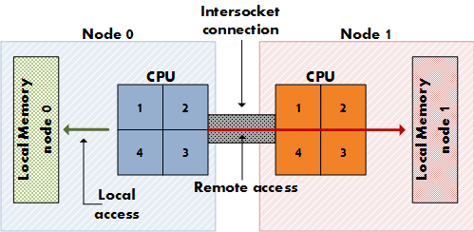
NUMA
Non-Uniform Memory Access
Memory access is slower when remote

Slide 13
Step-by-Step HPL Configuration
Choose block size (NB)
– A multiple of cache line size; Fit to L2 cache size
Calculate problem size (N)
– Keep some memory free for background tasks
Determine P * Q
– Balance threads & ranks; Utilise NUMA
What about the rest of the options…?

Slide 14
Other configurations
Threshold: value used for residual checks
BCASTs: how panel columns are sent to other processes
DEPTHs: how many panels to “look-ahead” while updating the current panel
SWAP: swapping algorithm used (binary exch. / spread-roll)
– swapping threshold mixes the two if “mix” is used
RFACTs, PFACTs, NDIVs, and NBMINs control the HPL algorithm

Slide 15

THANK YOU

