Slide 1


Automation and Provisioning (Ansible)
By Tebogo Diraditsile

Slide 2

The problem: doing it N times
A cluster has many nodes that must be configured identically
By hand: slow, error-prone, not repeatable
Miss one node → mysterious bugs during benchmarking
We need automation that is consistent and reproducible

Slide 3
What is Ansible?
An open-source tool for automating configuration and provisioning
Installation on the head node only
Uses SSH to communicate with the other nodes
You describe the desired state in simple, readable YAML

Slide 4
Scripts vs Ansible
Shell script = you write how to do it, step by step
Ansible = you write what you want, and it figures out the steps
Ansible works out which changes are needed to reach that state

Slide 5
Inventory: listing your nodes
The inventory tells Ansible which hosts to manage
Group hosts so you can target them together
Run a task on every compute node by naming the group
inventory.ini
[head]
head01
[compute]
compute01
compute02
compute03

Slide 6
Running Quick Commands
Great for quick checks across the whole cluster
terminal
# check every node is reachable
ansible all -i inventory.ini \
-m ping
# run a command on compute nodes
ansible compute -i inventory.ini \
-m command -a "uptime"

Slide 7
Ansible Playbooks
A playbook is a YAML file that describes the desired state
Made up of tasks to run
Each task uses a module

Slide 8
Ansible Modules
apt / yum / dnf: install packages (Ubuntu and Rocky)
copy / template: place config files on nodes
service: start and enable daemons
user: manage accounts across the cluster

Slide 9
Anatomy of a playbook
hosts: group to target
become: yes (run task as root)
tasks: The ordered steps to apply
Running the playbook:
setup.yml
- name: Configure compute nodes
hosts: compute
become: yes
tasks:
- name: Install build tools
apt:
name: build-essential
state: present
ansible-playbook -i inventory.ini setup.yml

Slide 10
Idempotency
Re-running only changes what is not already correct
Safe to run anytime; the cluster converges to your desired state
This is what sets Ansible apart from a plain shell script
terminal
# first run — it installs the package
ansible-playbook -i inventory.ini setup.yml
... changed=1
# second run — nothing to do
ansible-playbook -i inventory.ini setup.yml
... changed=0 (ok)

Slide 11
Provisioning: creating the node itself
So far, we have configured nodes that already exist
What if you want to automate the process of deploying nodes?
Ansible can create a node on OpenStack, then configure it

Slide 12
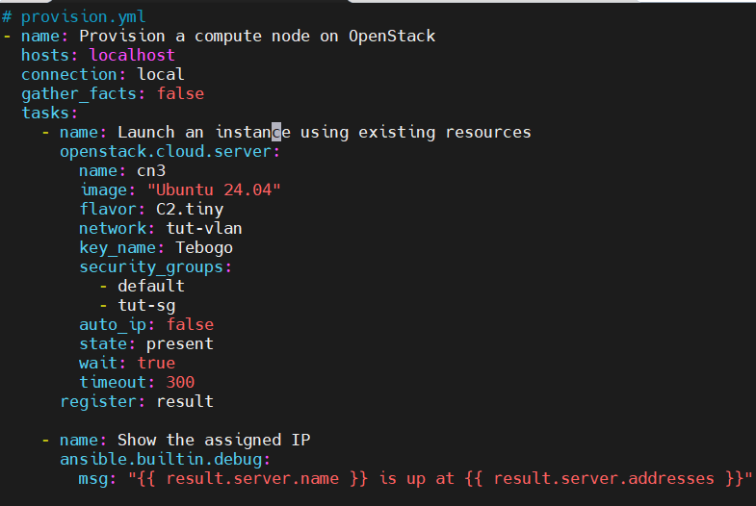
Provisioning (Playbook)

Slide 13
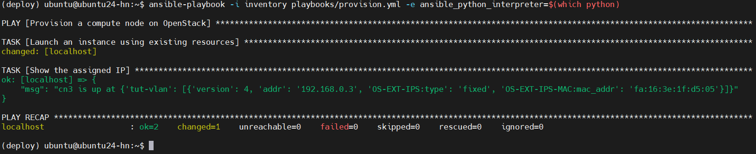
Provisioning (Output 1)

Slide 14
Provisioning (Output 2)

Slide 15
Example 2
Live Demo or Pre-recorded Demo

Slide 16

THANK YOU

